Slide 1
Constrained motion on surfaces
Computational Physics I - PHYCS425
Authors:
Ali Merza Isa 20186917
Asif Bin Ayub 20191251
Kumail Abdulaziz 20196080

Slide 2
Table of contents
Introduction
Theory
1
2
Part I
Part II
3
4
Constrained motion
Runge-Kutta method (RK4)
Constrained motion in 1D
Constrained motion in 2D

Slide 3
1
Introduction
Constrained motion

Slide 4
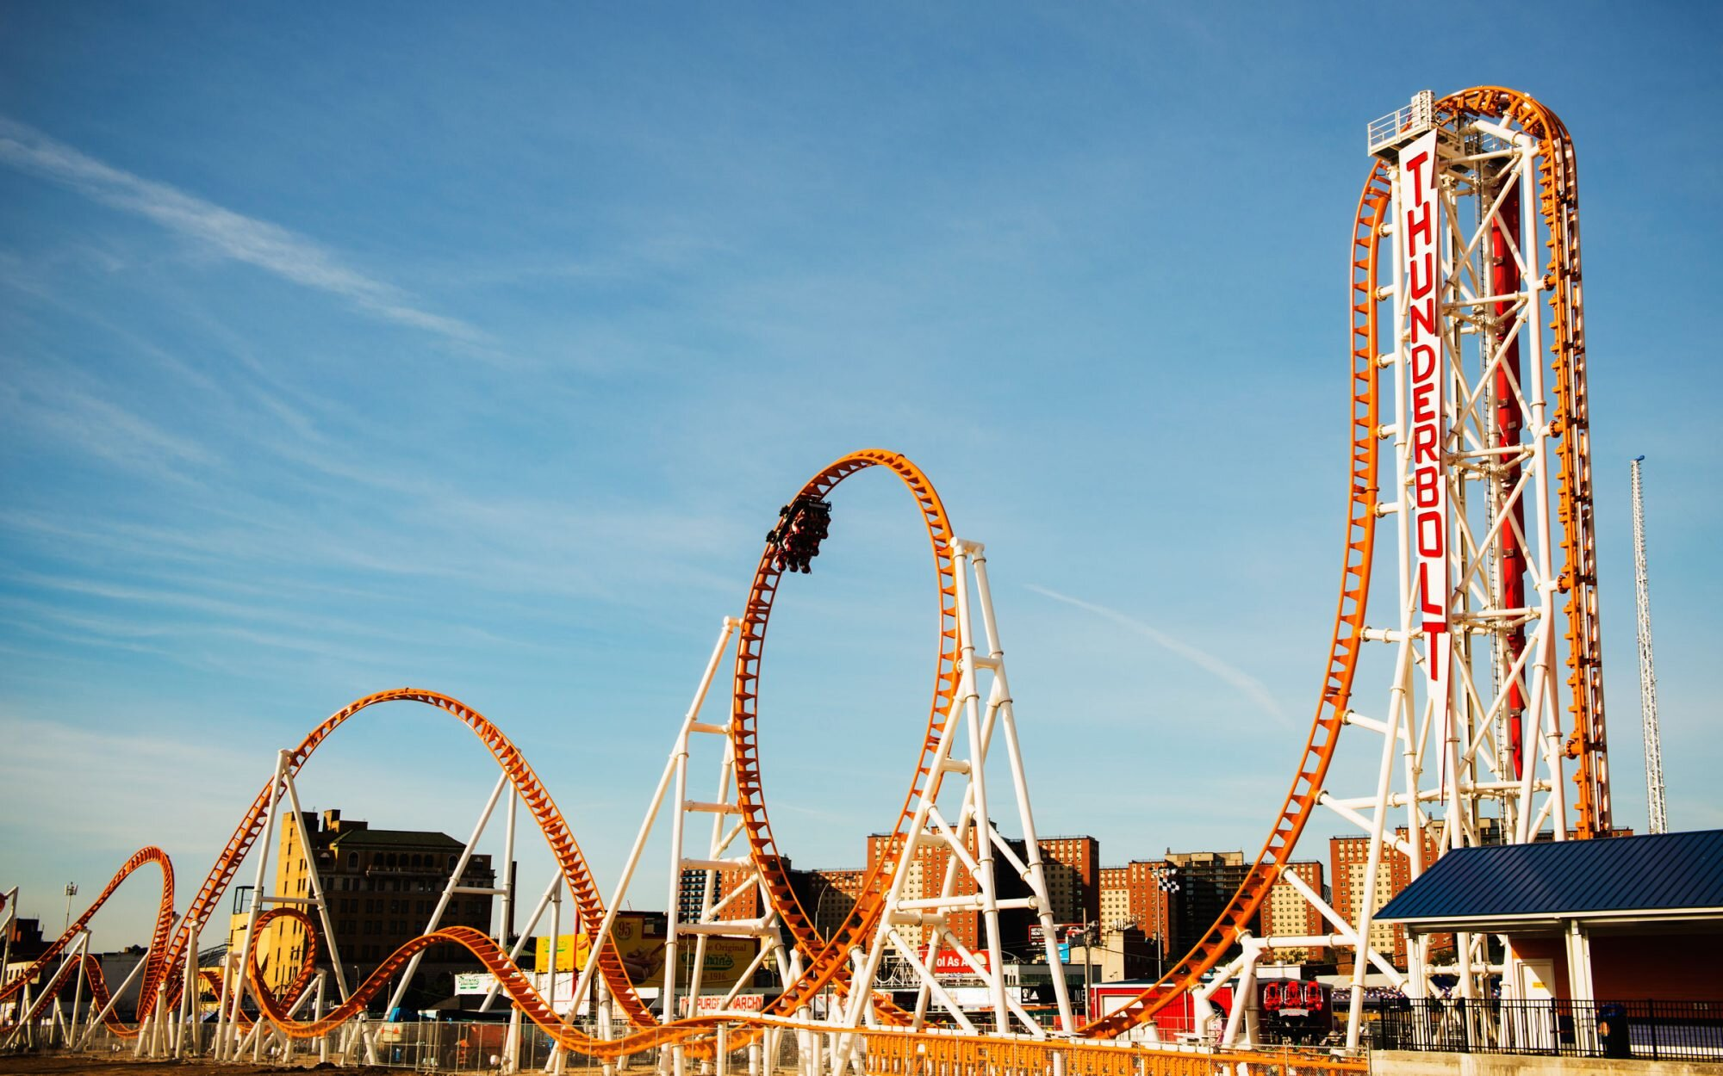
Where can you see constrained motion?
Mercury is the closest planet to the Sun and the smallest one in the Solar System—it’s only a bit larger than the Moon

Slide 5
2
Theory
Runge-Kutta method (RK4)

Slide 6
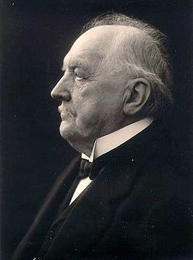
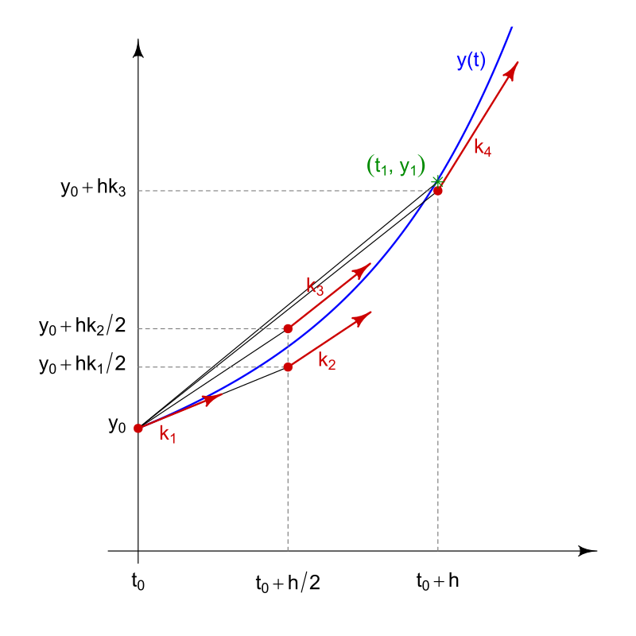
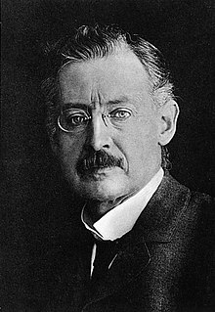
Runge-Kutta method (RK4)
Mercury is the closest planet to the Sun and the smallest one in the Solar System—it’s only a bit larger than the Moon

Slide 7
3
Part I
Constrained motion in 1D

Slide 8
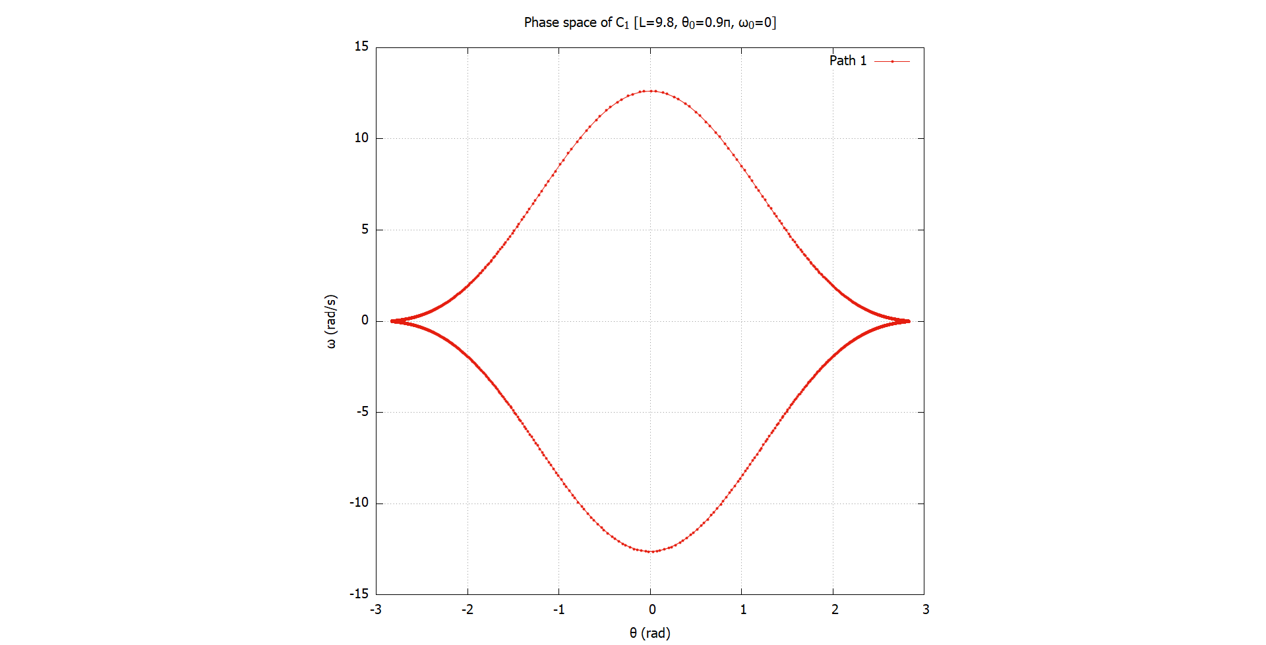
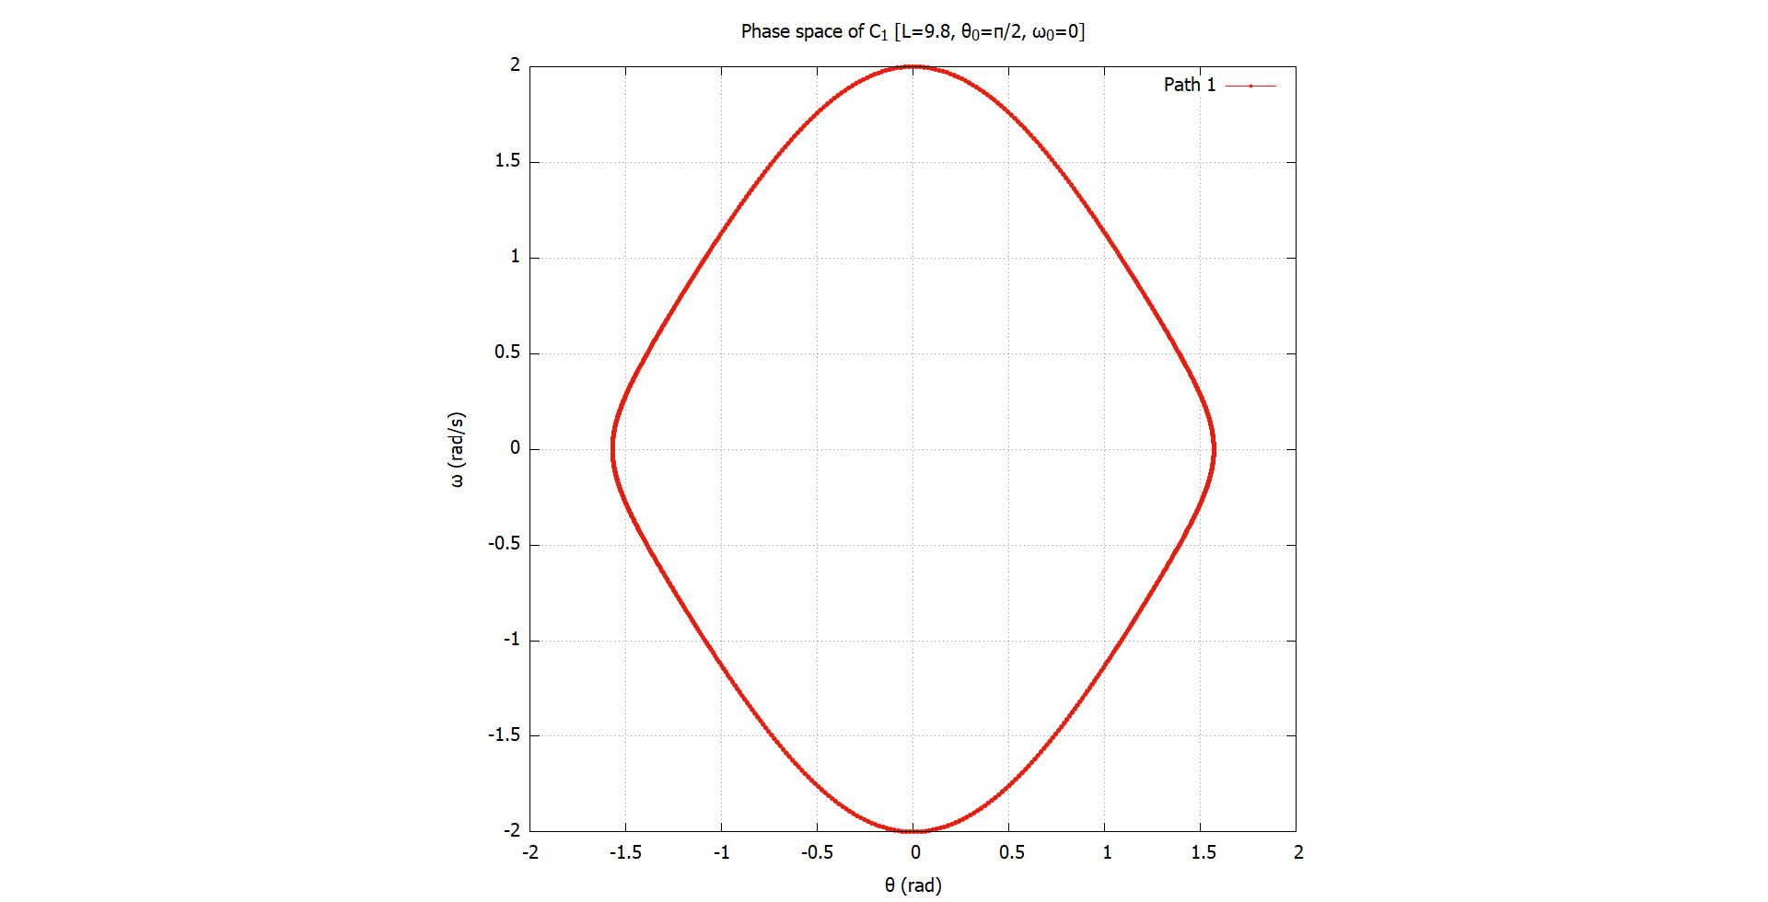
Mercury
Oscillatory motion and equilibrium points
Mercury is the closest planet to the Sun and the smallest one in the Solar System—it’s only a bit larger than the Moon

Slide 9
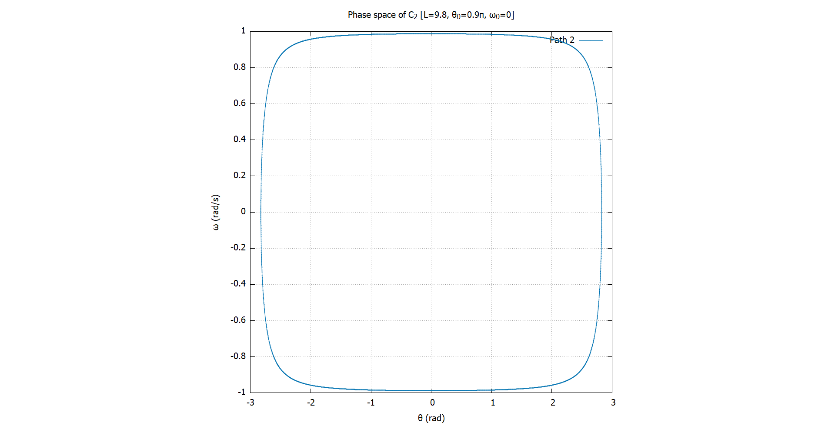
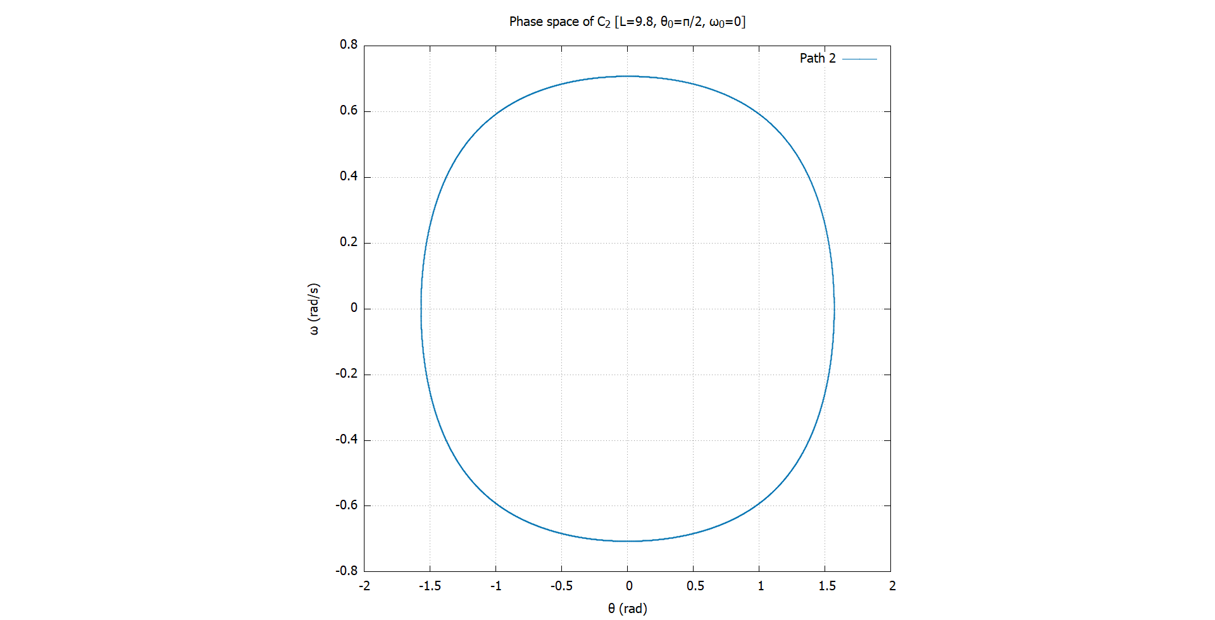
Mercury
Oscillatory motion and equilibrium points
Mercury is the closest planet to the Sun and the smallest one in the Solar System—it’s only a bit larger than the Moon

Slide 10
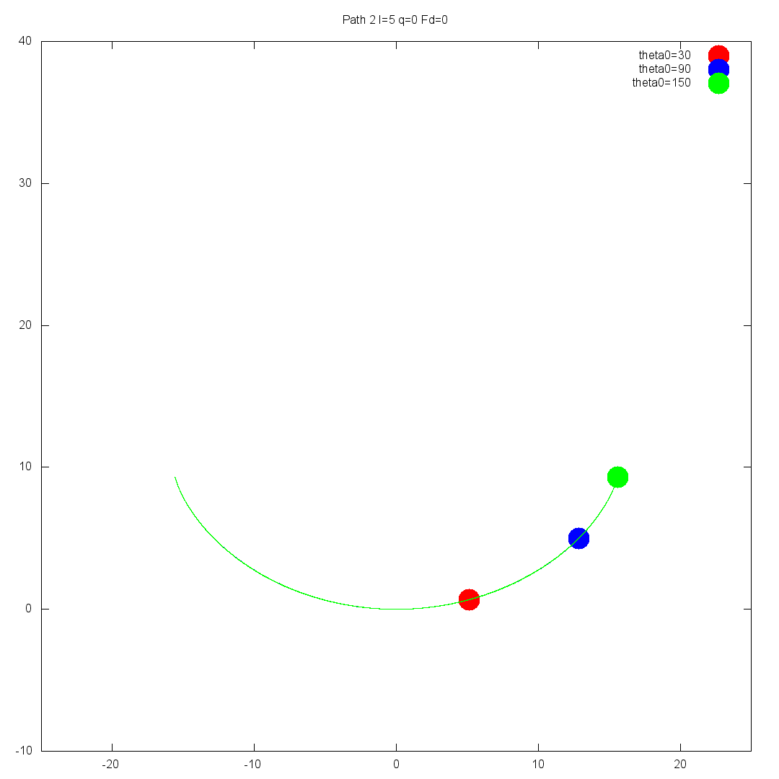
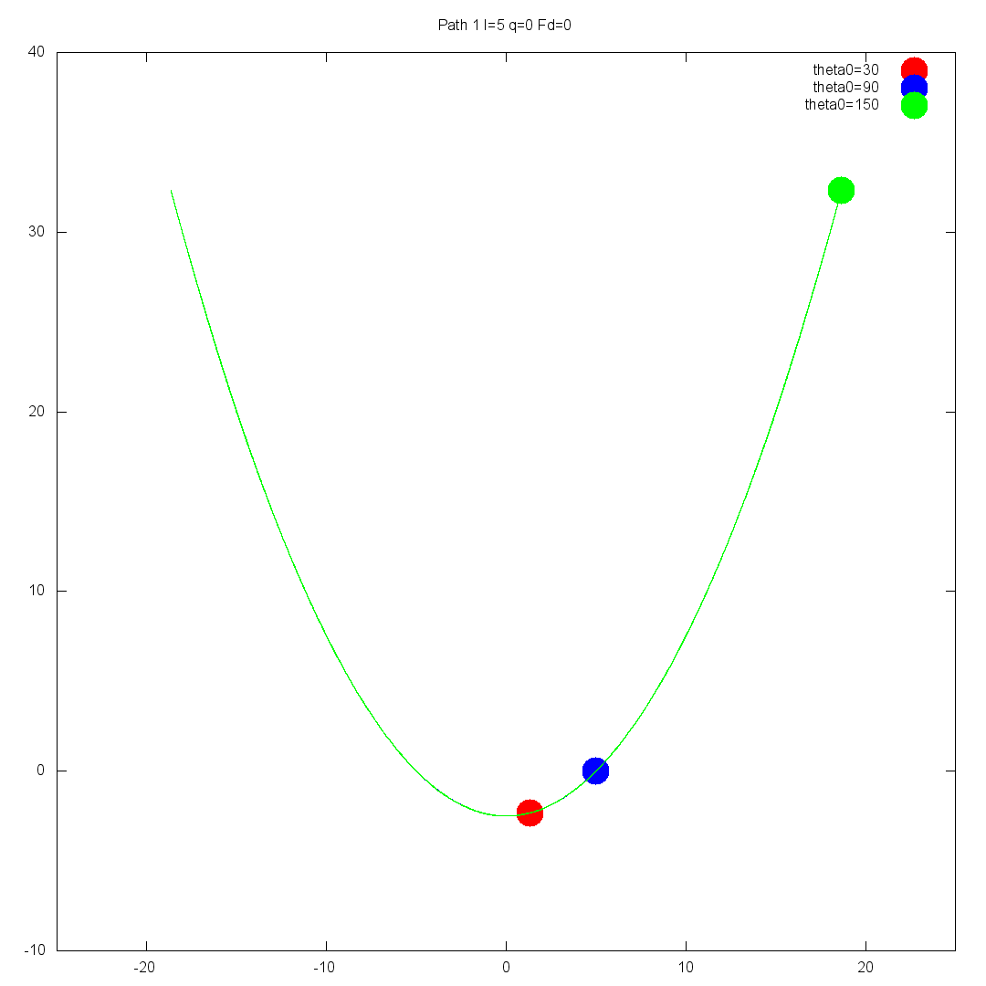
Period (T) vs. Amplitude (Ѳ)
Mercury is the closest planet to the Sun and the smallest one in the Solar

Slide 11
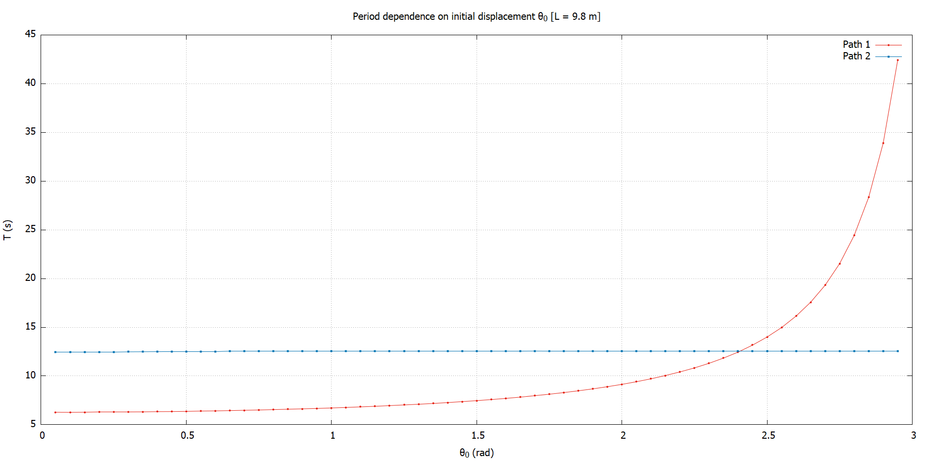
Mercury
Period (T) vs. Amplitude (Ѳ)
Mercury is the closest planet to the Sun and the smallest one in the Solar System—it’s only a bit larger than the Moon

Slide 12
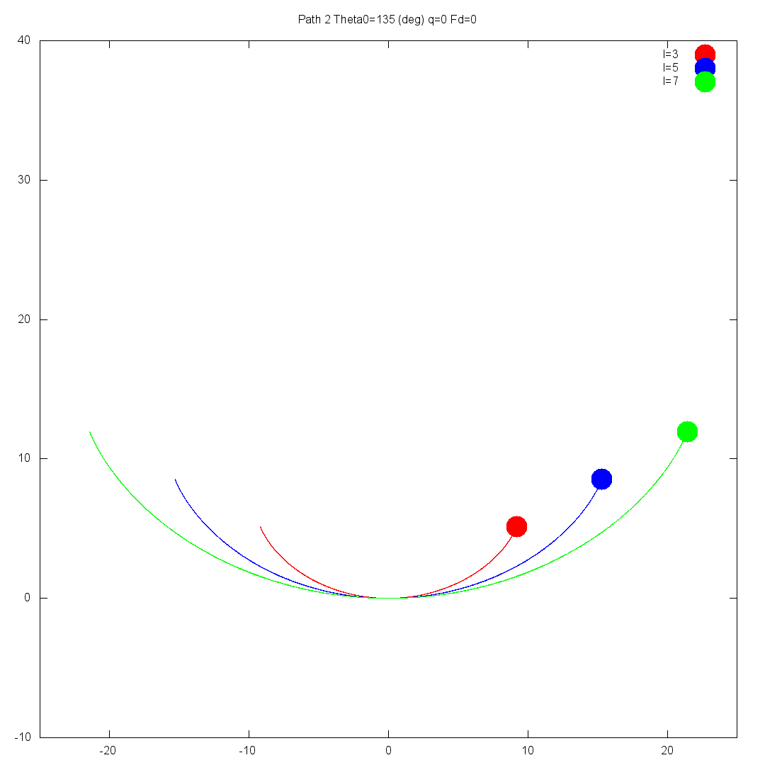
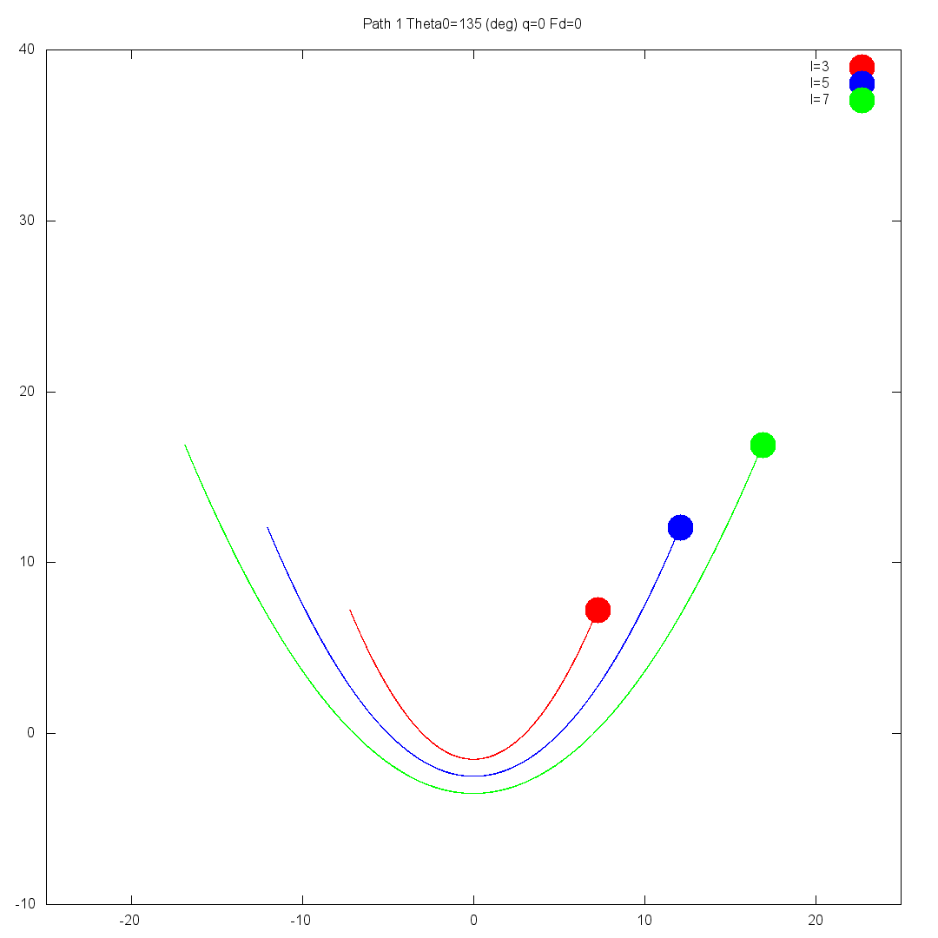
Period (T) vs. Length parameter (l)
Mercury is the closest planet to the Sun and the smallest one in the Solar

Slide 13
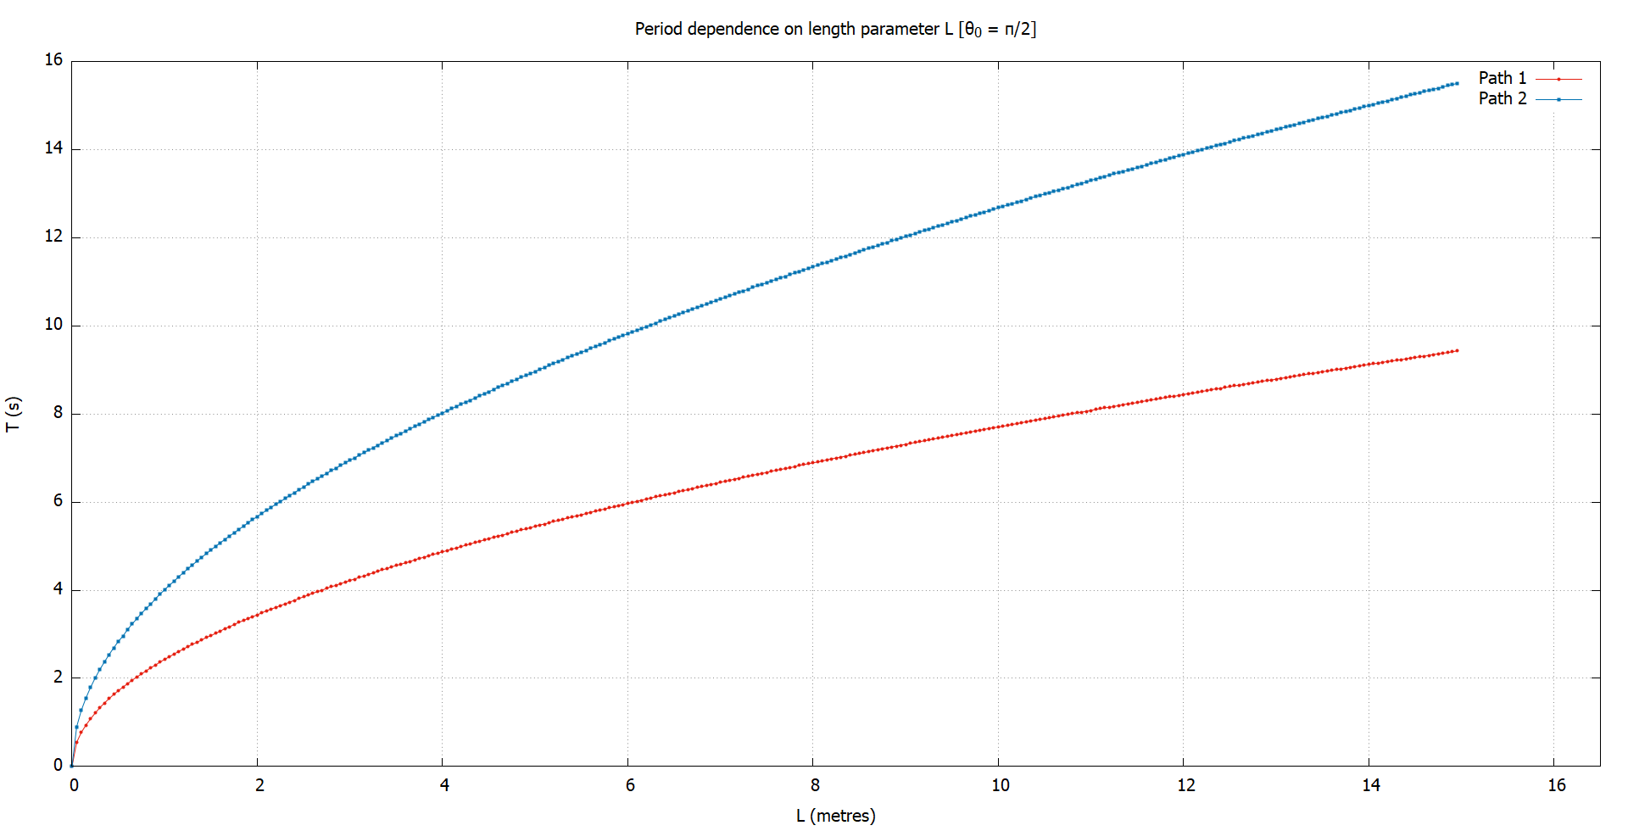
Mercury
Period (T) vs. Length parameter (l)
Mercury is the closest planet to the Sun and the smallest one in the Solar System—it’s only a bit larger than the Moon

Slide 14
Mercury
Period (T) as a function of (l) and (Ѳ)
PUT HERE THE FUNCTIONS WE DERIVED
Mercury is the closest planet to the Sun and the smallest one in the Solar System—it’s only a bit larger than the Moon
Mercury

Slide 15
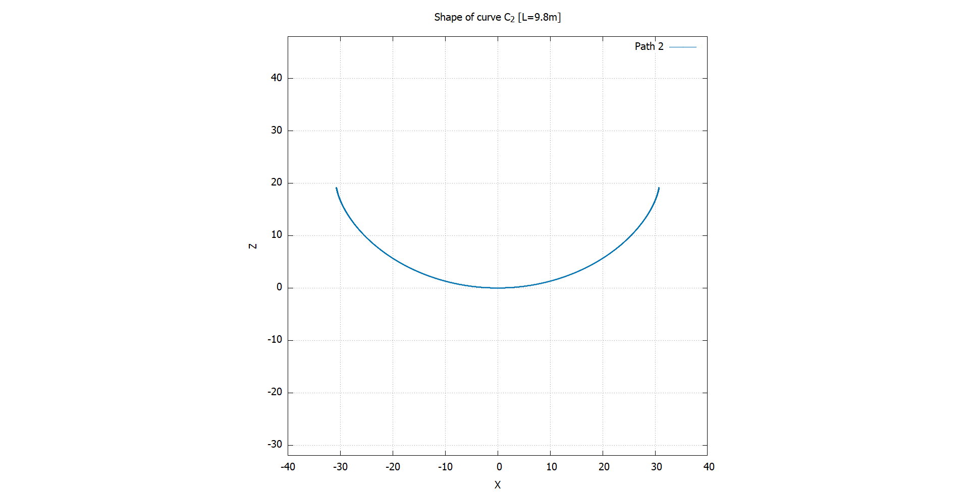
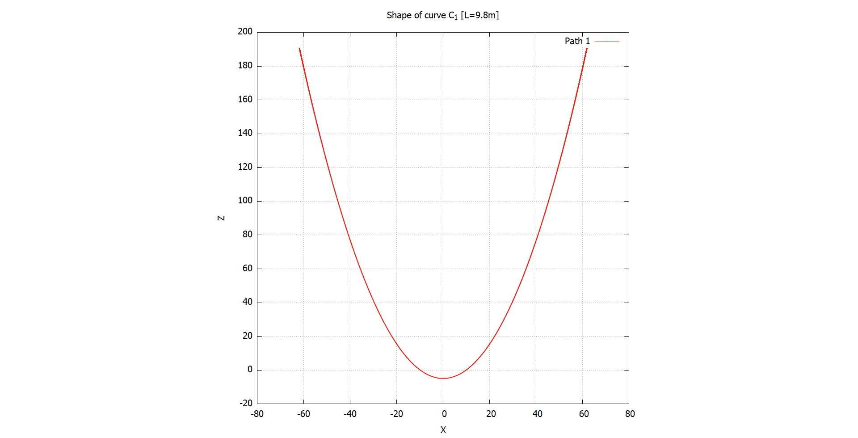
Identifying paths
Mercury is the closest planet to the Sun and the smallest one in the Solar

Slide 16
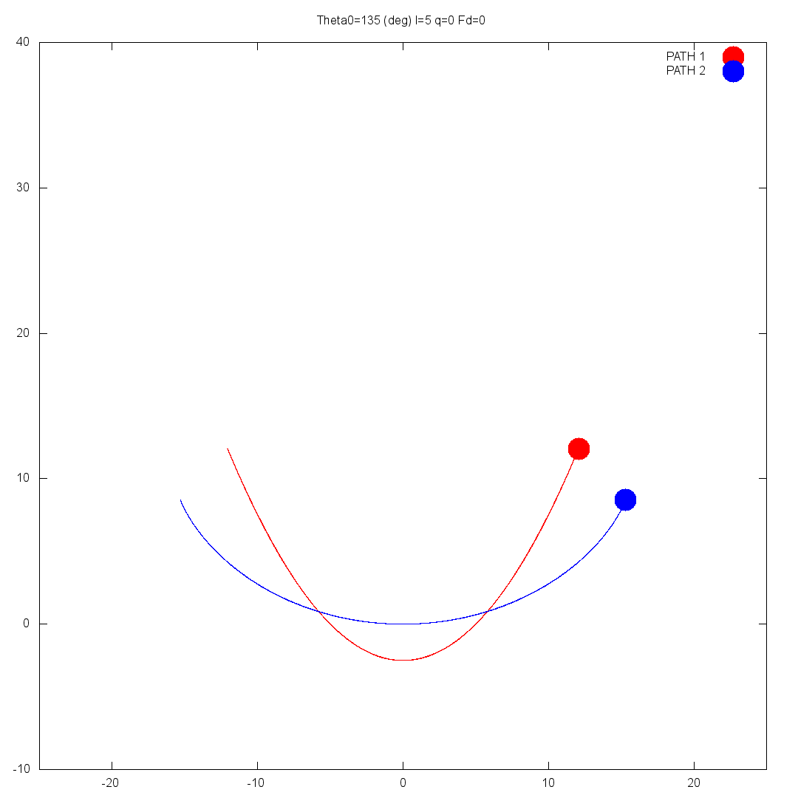
Identifying paths

Slide 17
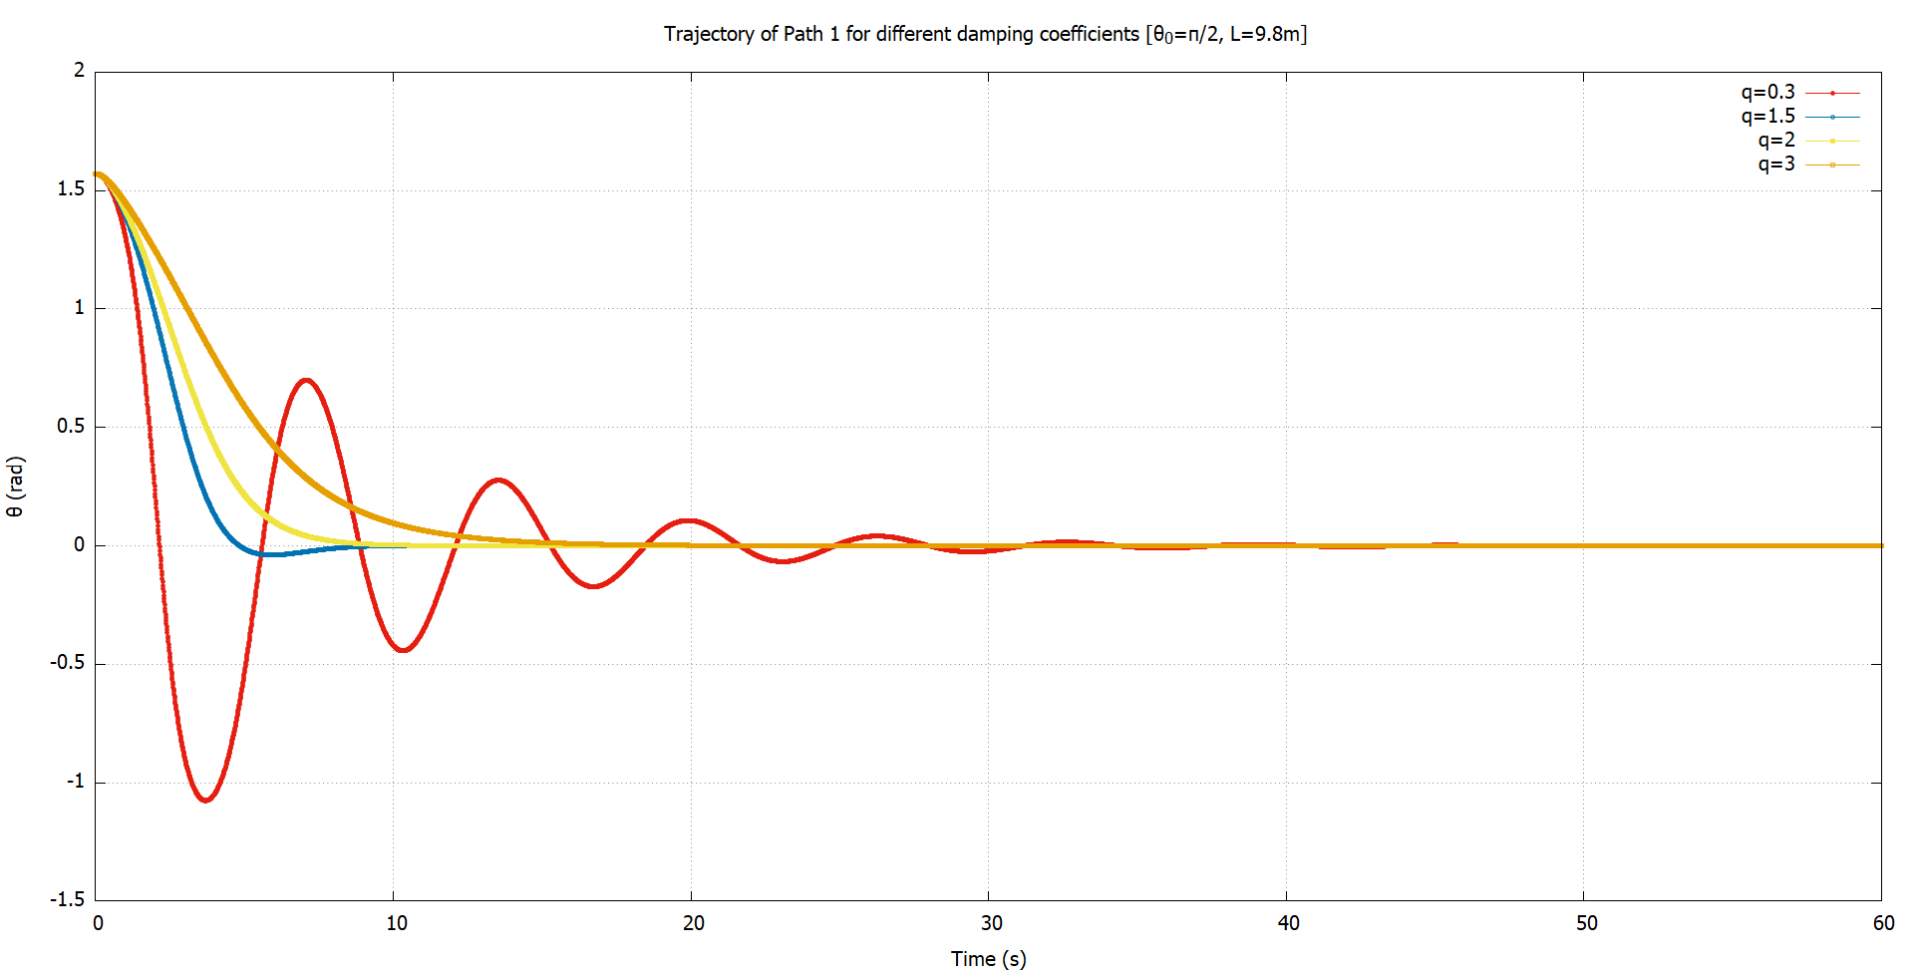
Damping
Routes to chaos
Mercury is the closest planet to the Sun and the smallest one in the Solar System—it’s only a bit larger than the Moon

Slide 18
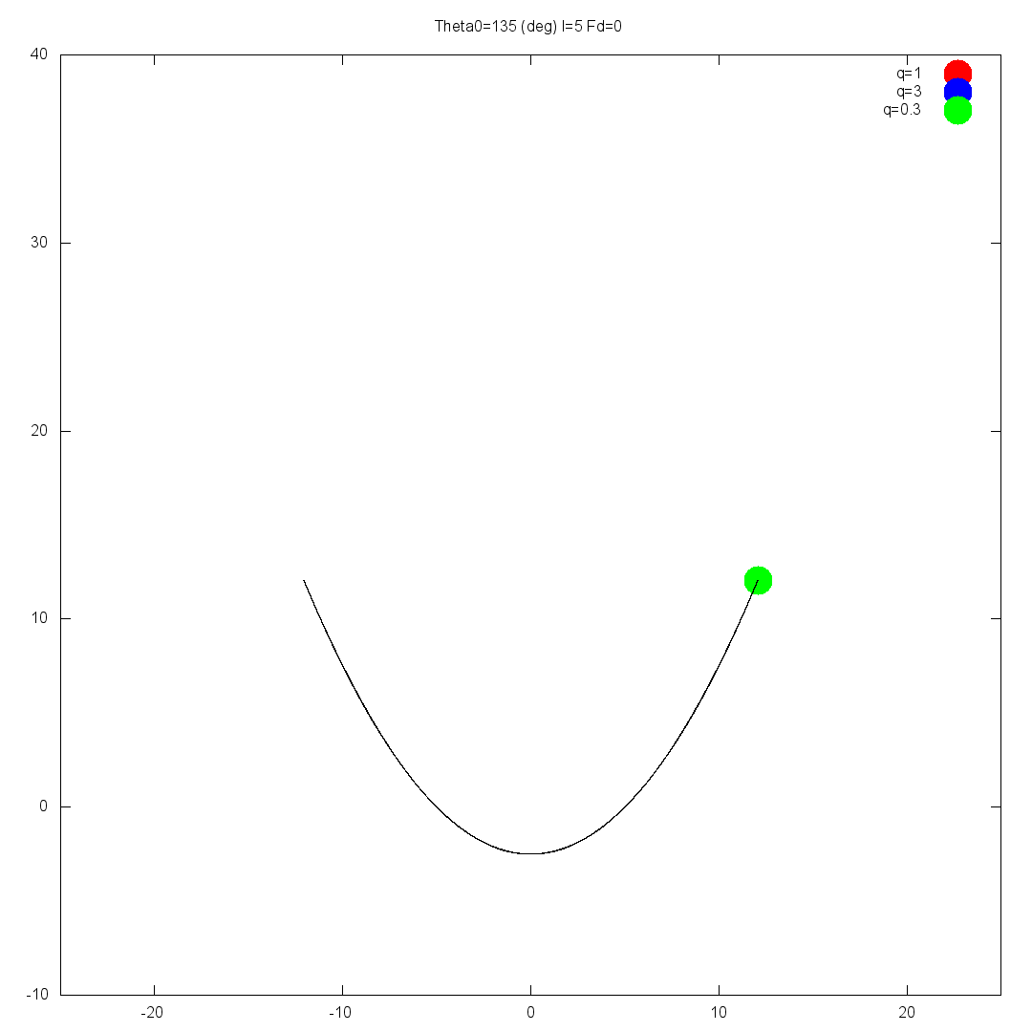
Routes to chaos

Slide 19
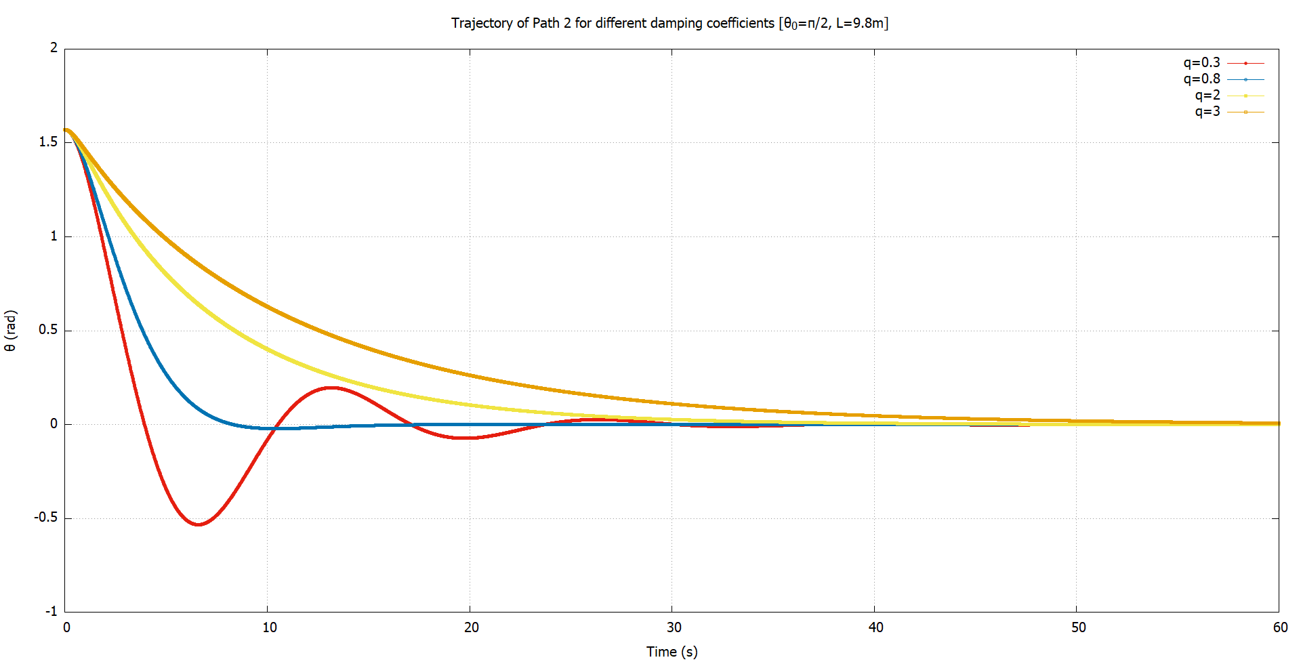
Damping
Routes to chaos
Mercury is the closest planet to the Sun and the smallest one in the Solar System—it’s only a bit larger than the Moon

Slide 20
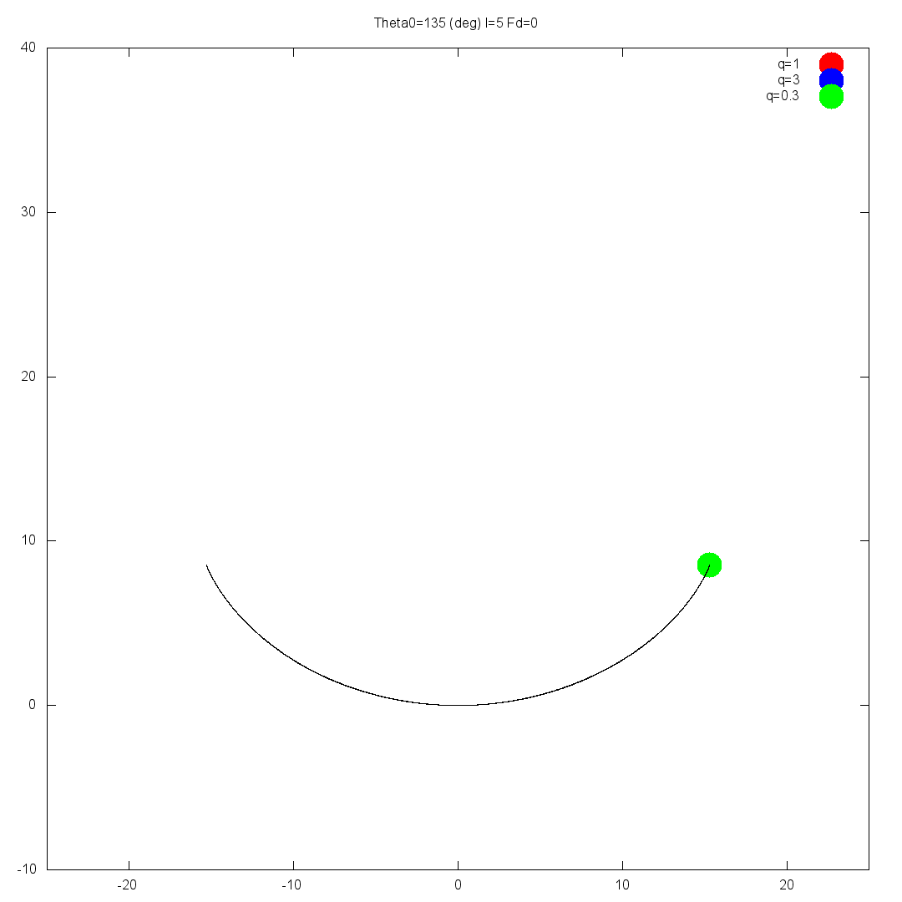
Routes to chaos

Slide 21
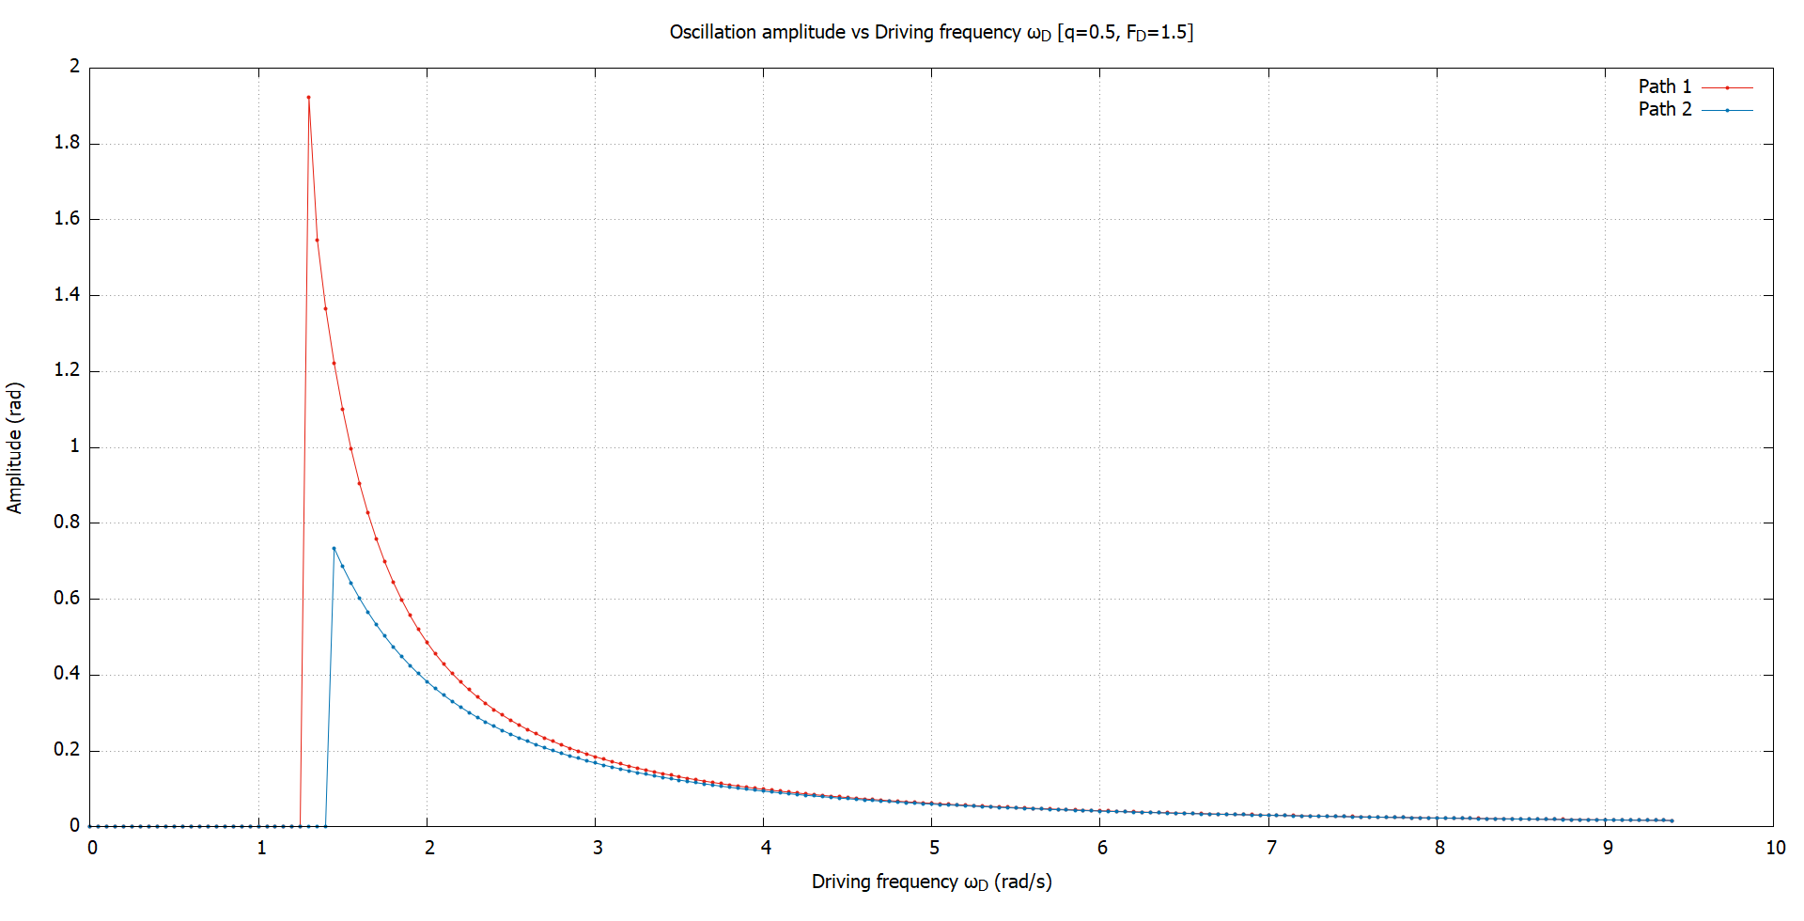
Driving frequency
Routes to chaos
Mercury is the closest planet to the Sun and the smallest one in the Solar System—it’s only a bit larger than the Moon

Slide 22
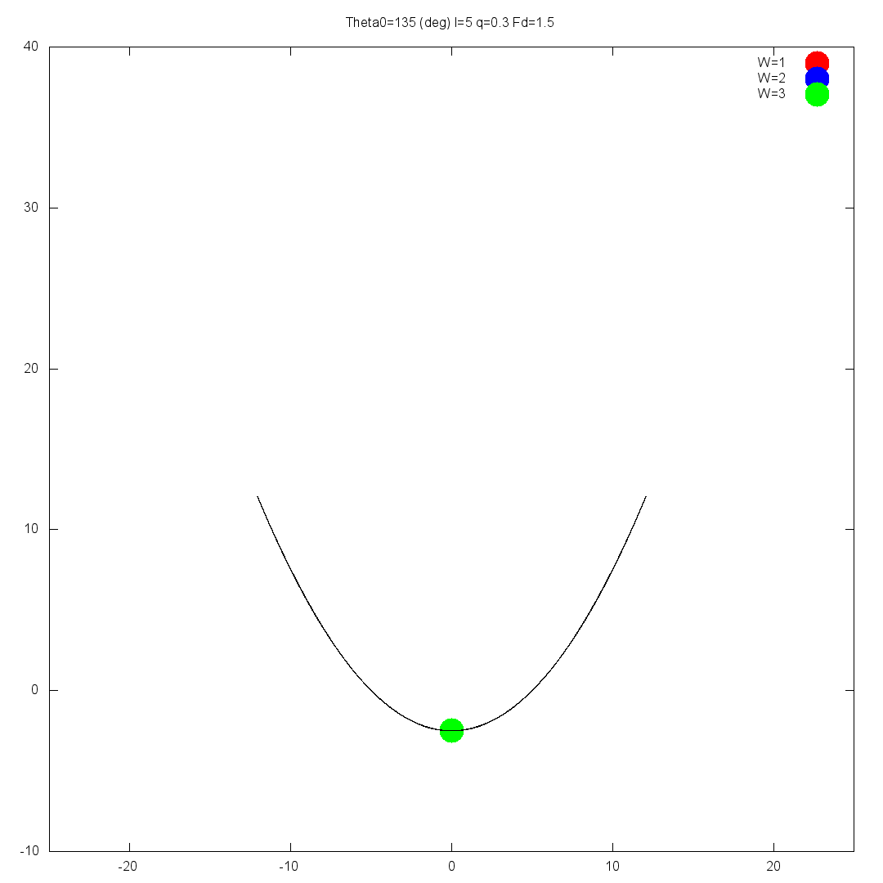
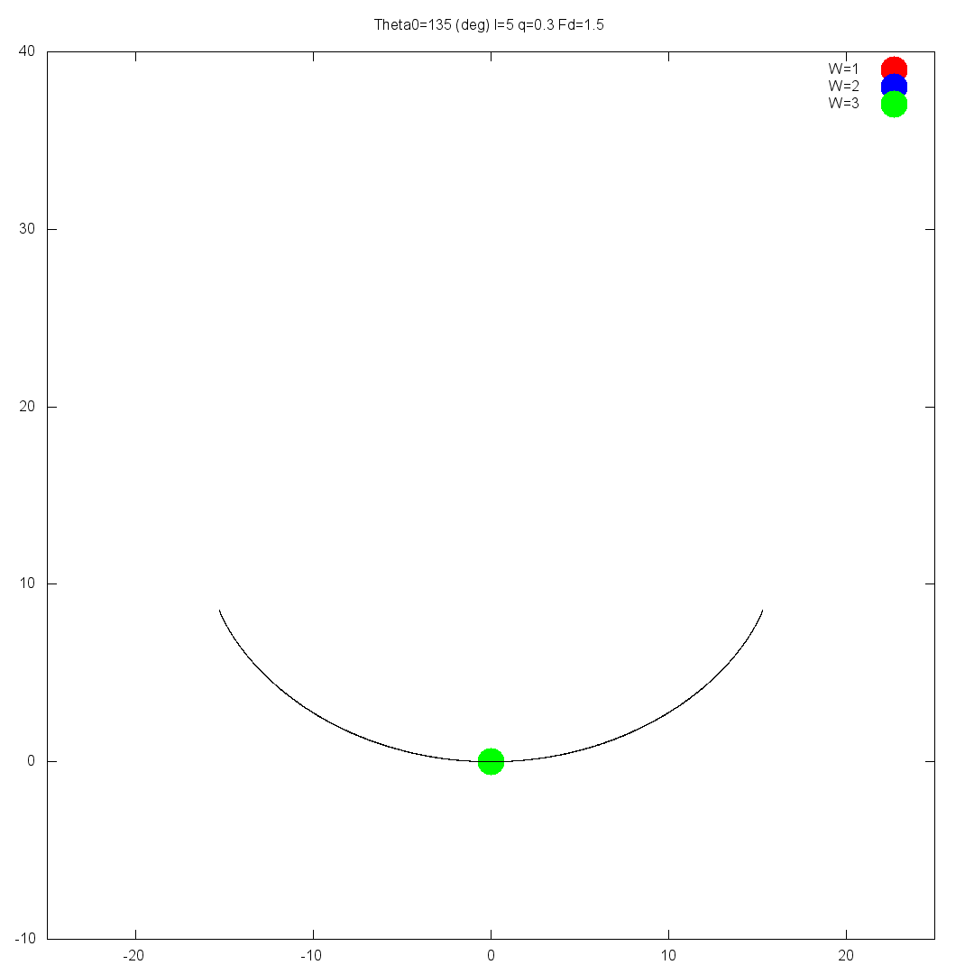
Routes to chaos
Mercury is the closest planet to the Sun and the smallest one in the Solar

Slide 23
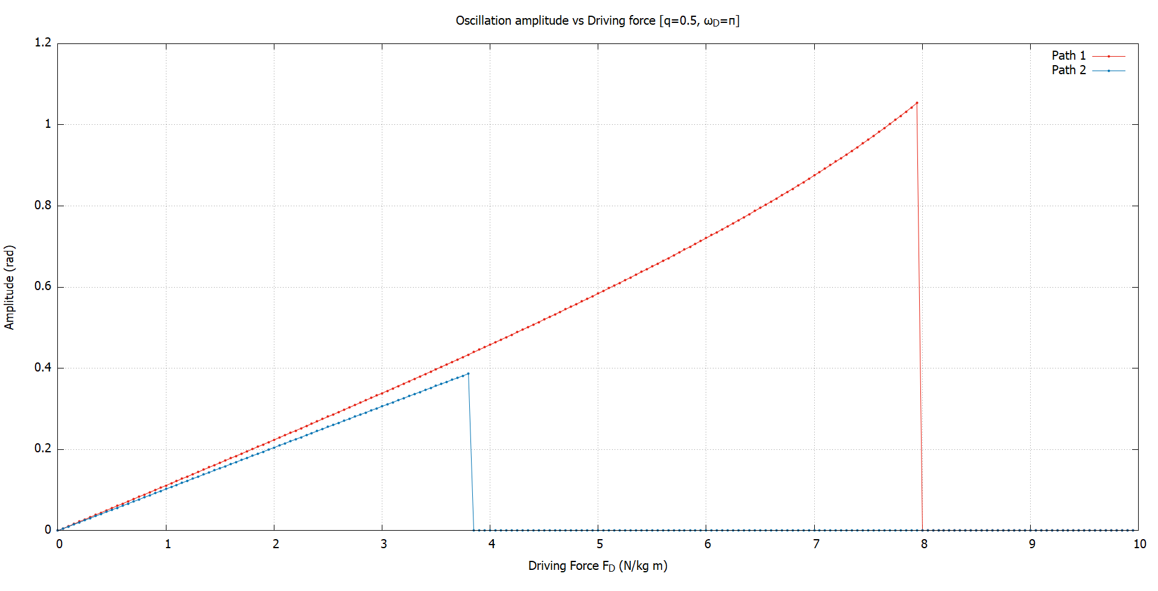
Driving Amplitude
Routes to chaos
Mercury is the closest planet to the Sun and the smallest one in the Solar System—it’s only a bit larger than the Moon

Slide 24
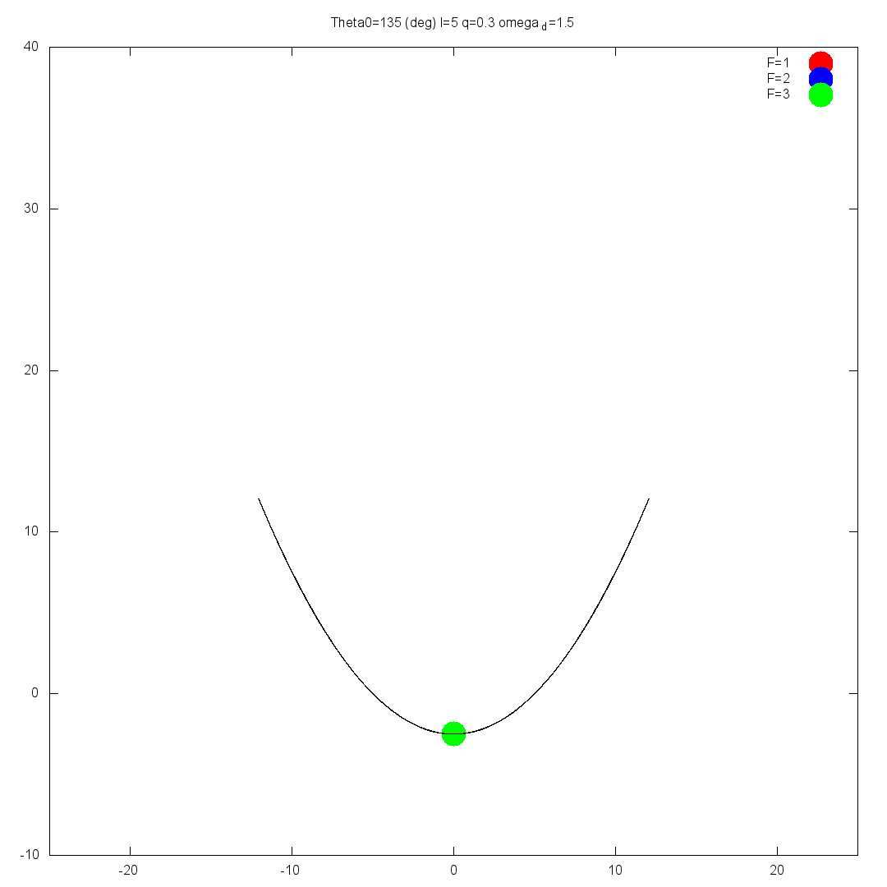
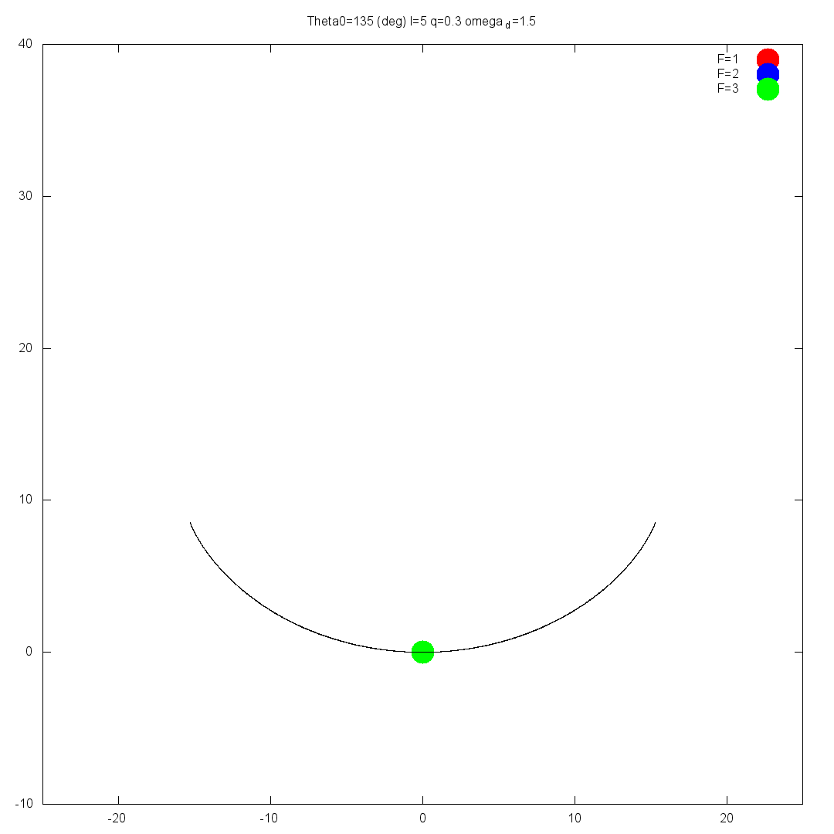
Routes to chaos
Mercury is the closest planet to the Sun and the smallest one in the Solar

Slide 25
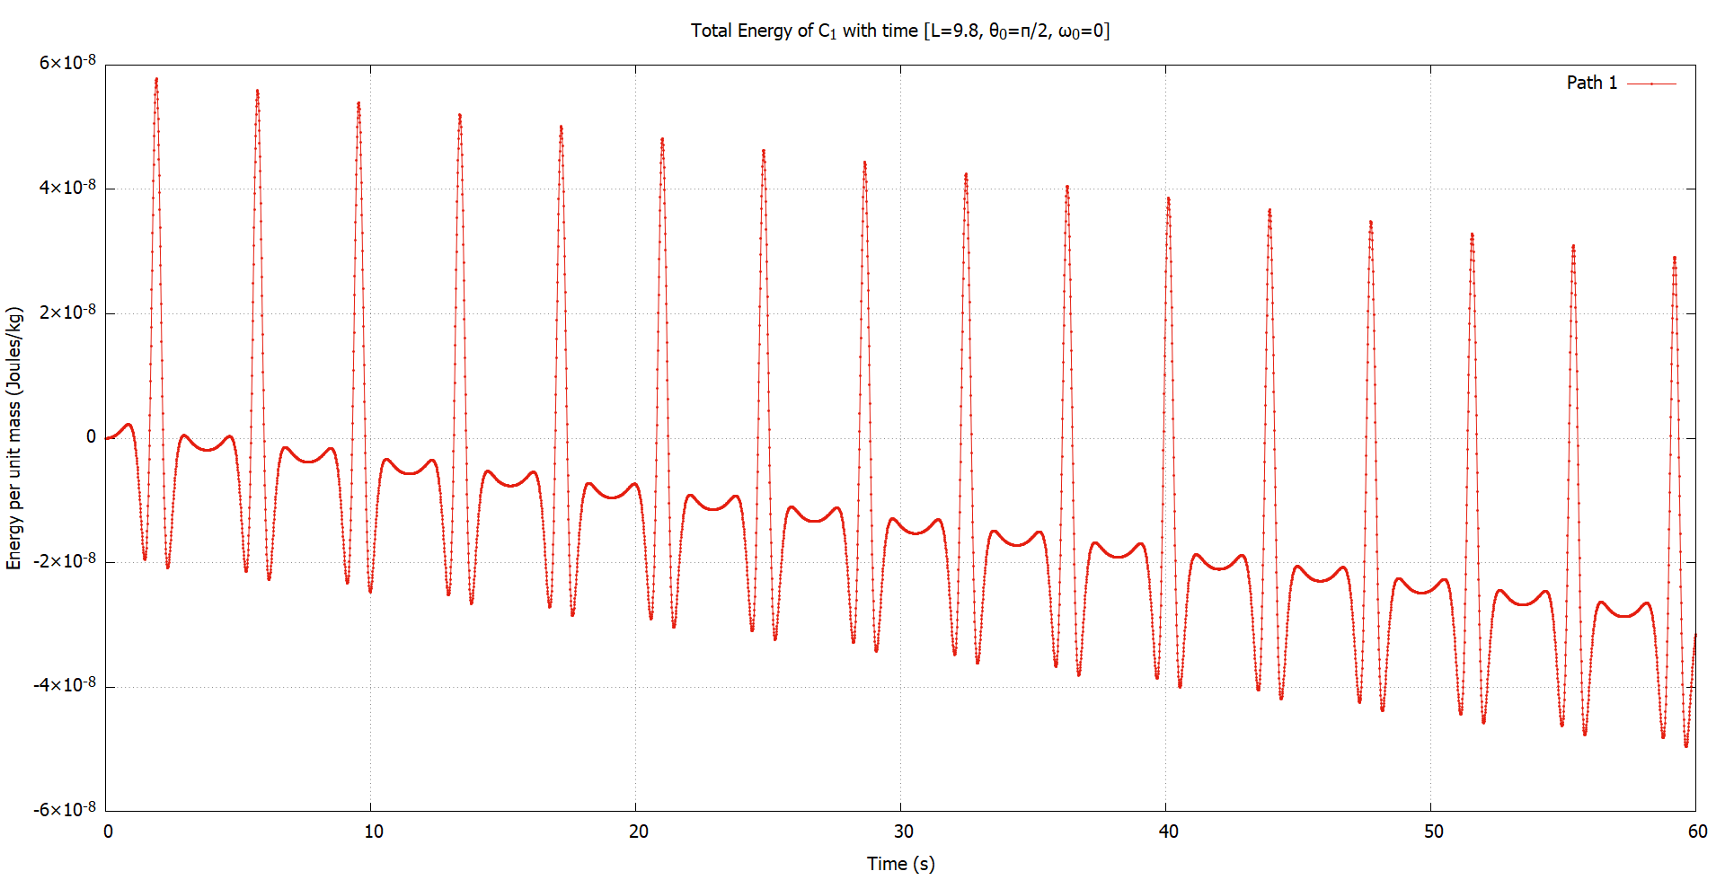
Bla Bla
Conservation of energy
Mercury is the closest planet to the Sun and the smallest one in the Solar System—it’s only a bit larger than the Moon

Slide 26
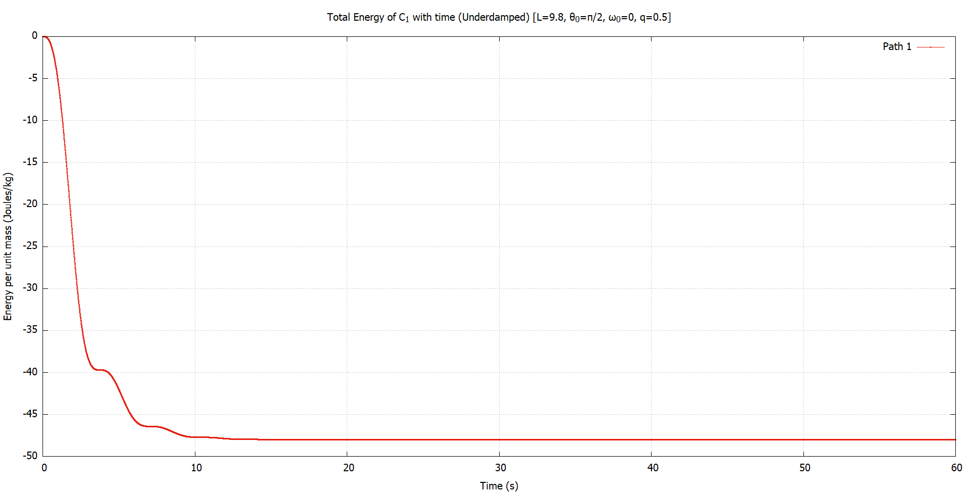
Bla Bla
Conservation of energy
Mercury is the closest planet to the Sun and the smallest one in the Solar System—it’s only a bit larger than the Moon

Slide 27
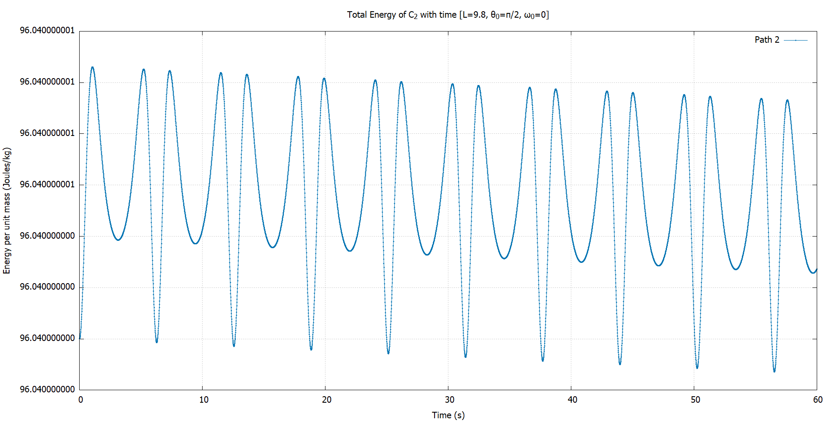
Bla Bla
Conservation of energy
Mercury is the closest planet to the Sun and the smallest one in the Solar System—it’s only a bit larger than the Moon

Slide 28
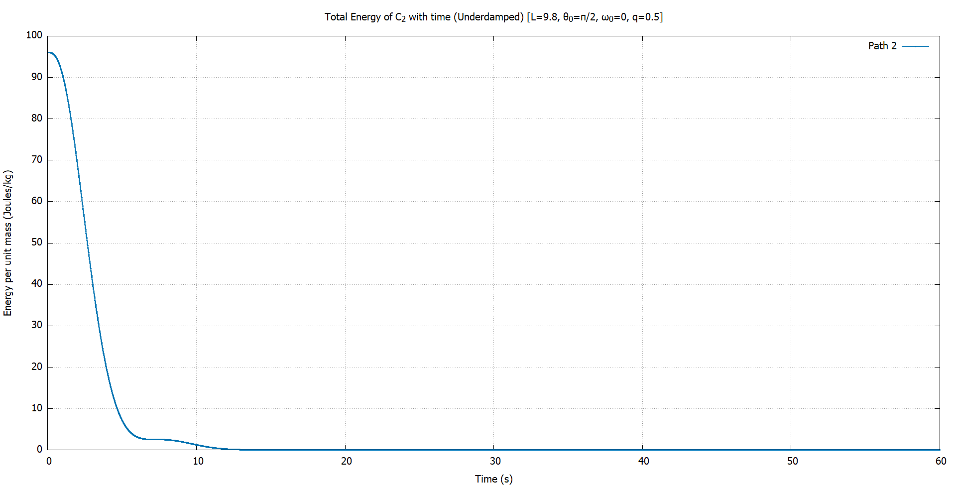
Bla Bla
Conservation of energy
Mercury is the closest planet to the Sun and the smallest one in the Solar System—it’s only a bit larger than the Moon

Slide 29
4
Part II
Constrained motion in 2D

Slide 30
Phase space
Oscillatory motion
Mercury is the closest planet to the Sun and the smallest one in the Solar System—it’s only a bit larger than the Moon

Slide 31
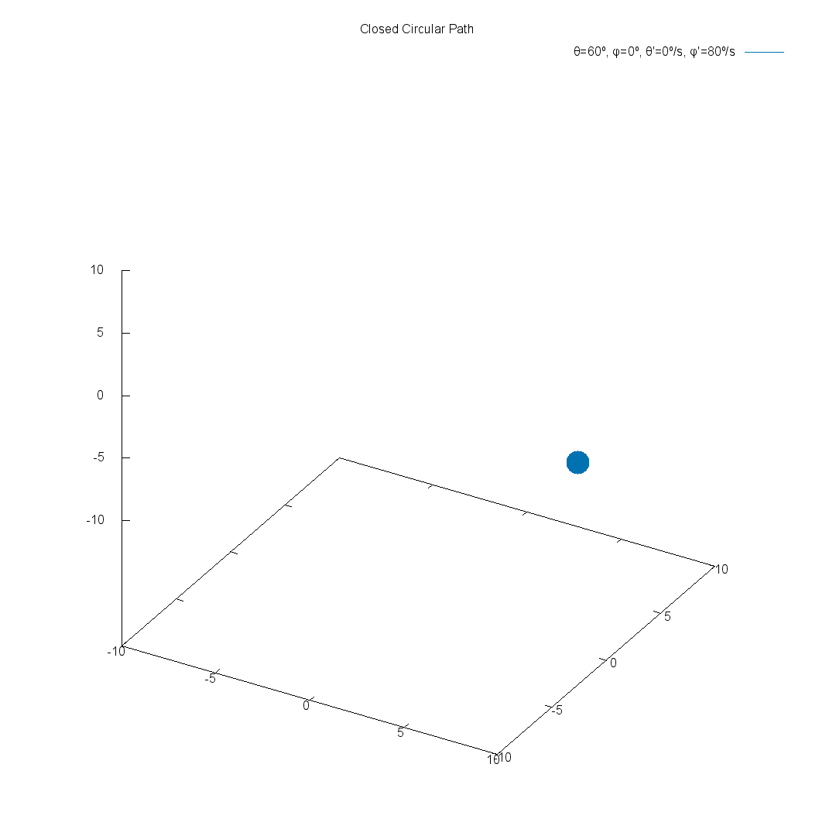
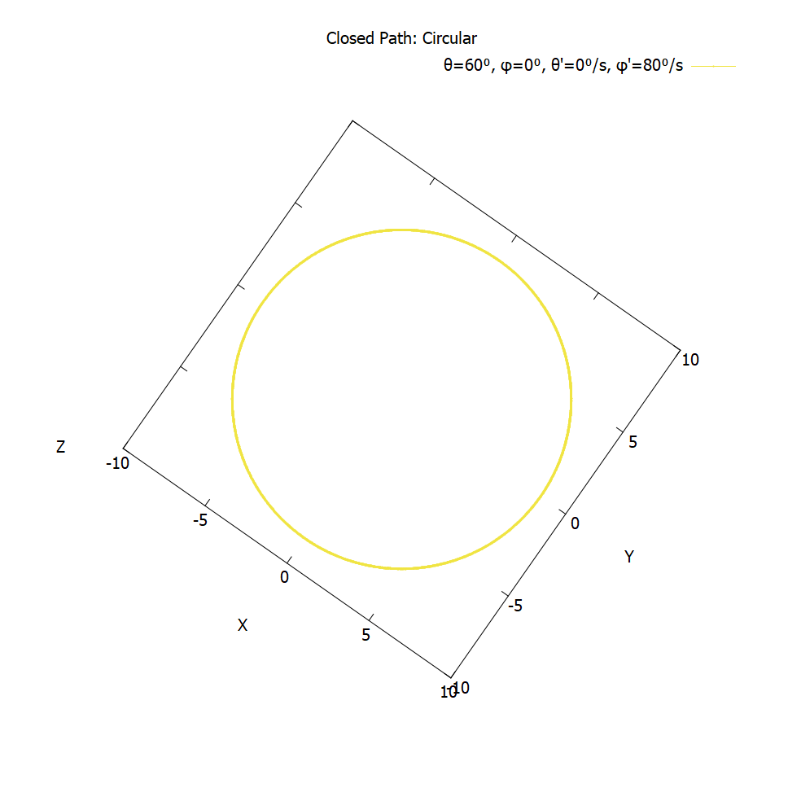
Closed paths
Mercury is the closest planet to the Sun and the smallest one in the Solar

Slide 32
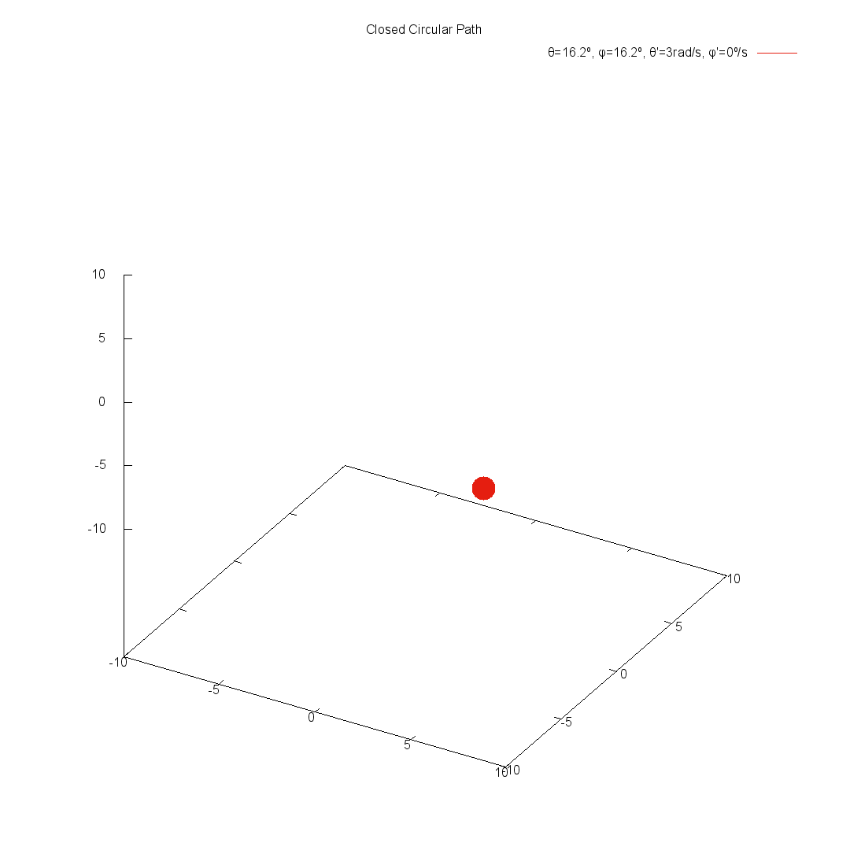
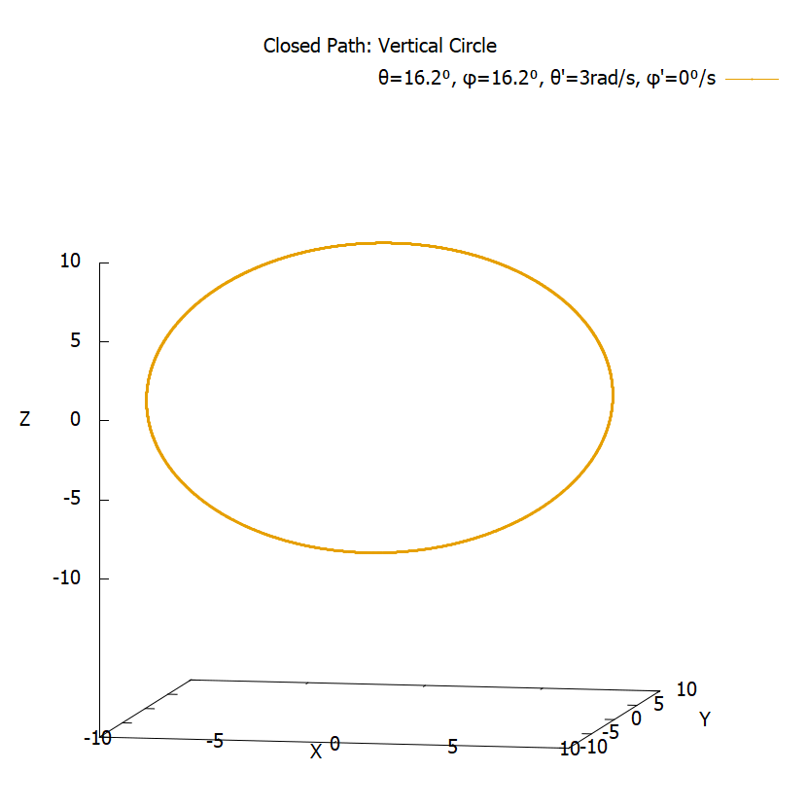
Closed paths
Mercury is the closest planet to the Sun and the smallest one in the Solar

Slide 33
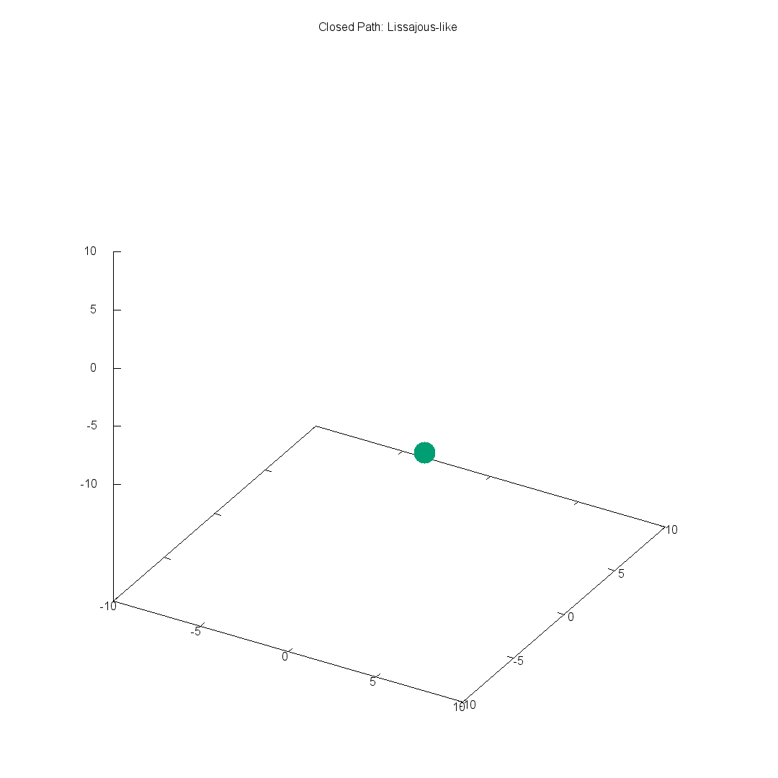
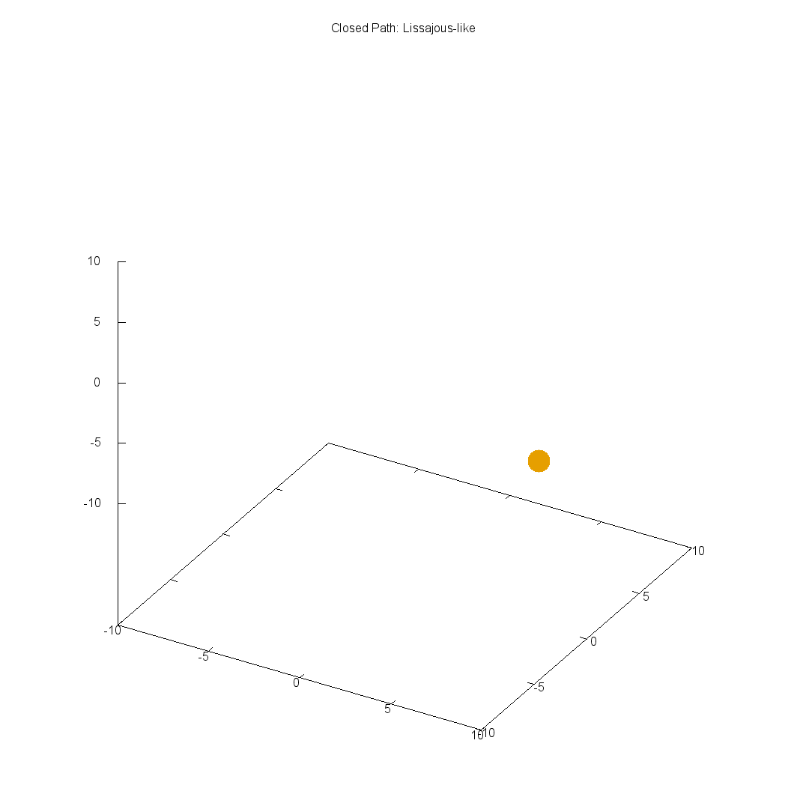
Closed paths
Mercury is the closest planet to the Sun and the smallest one in the Solar

Slide 34
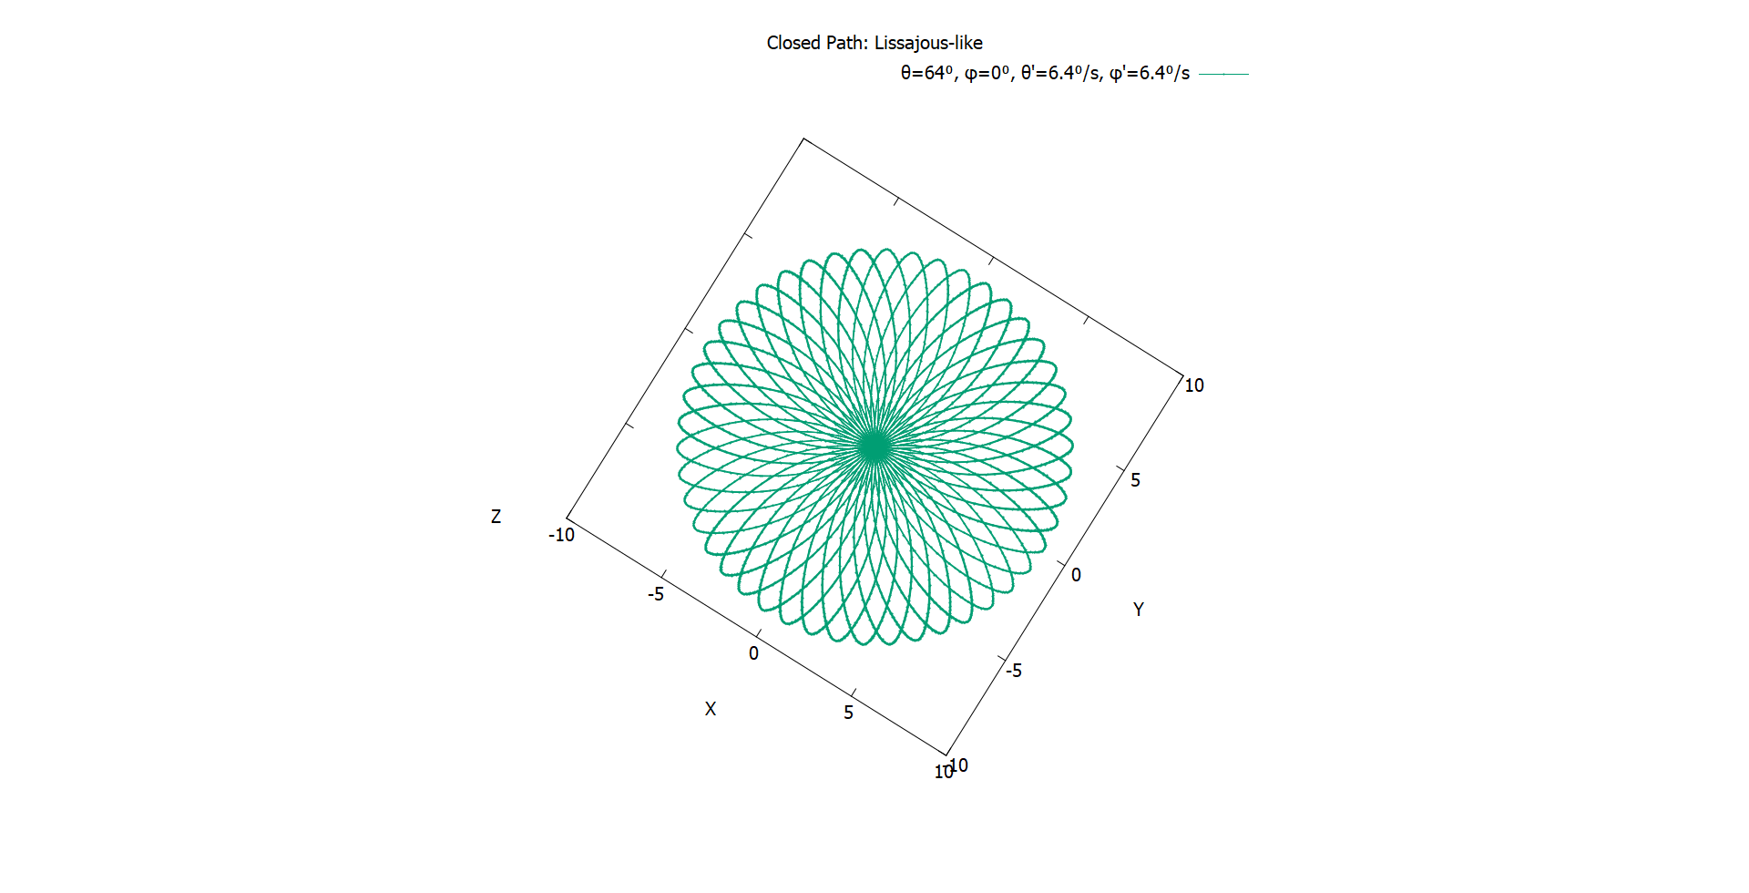
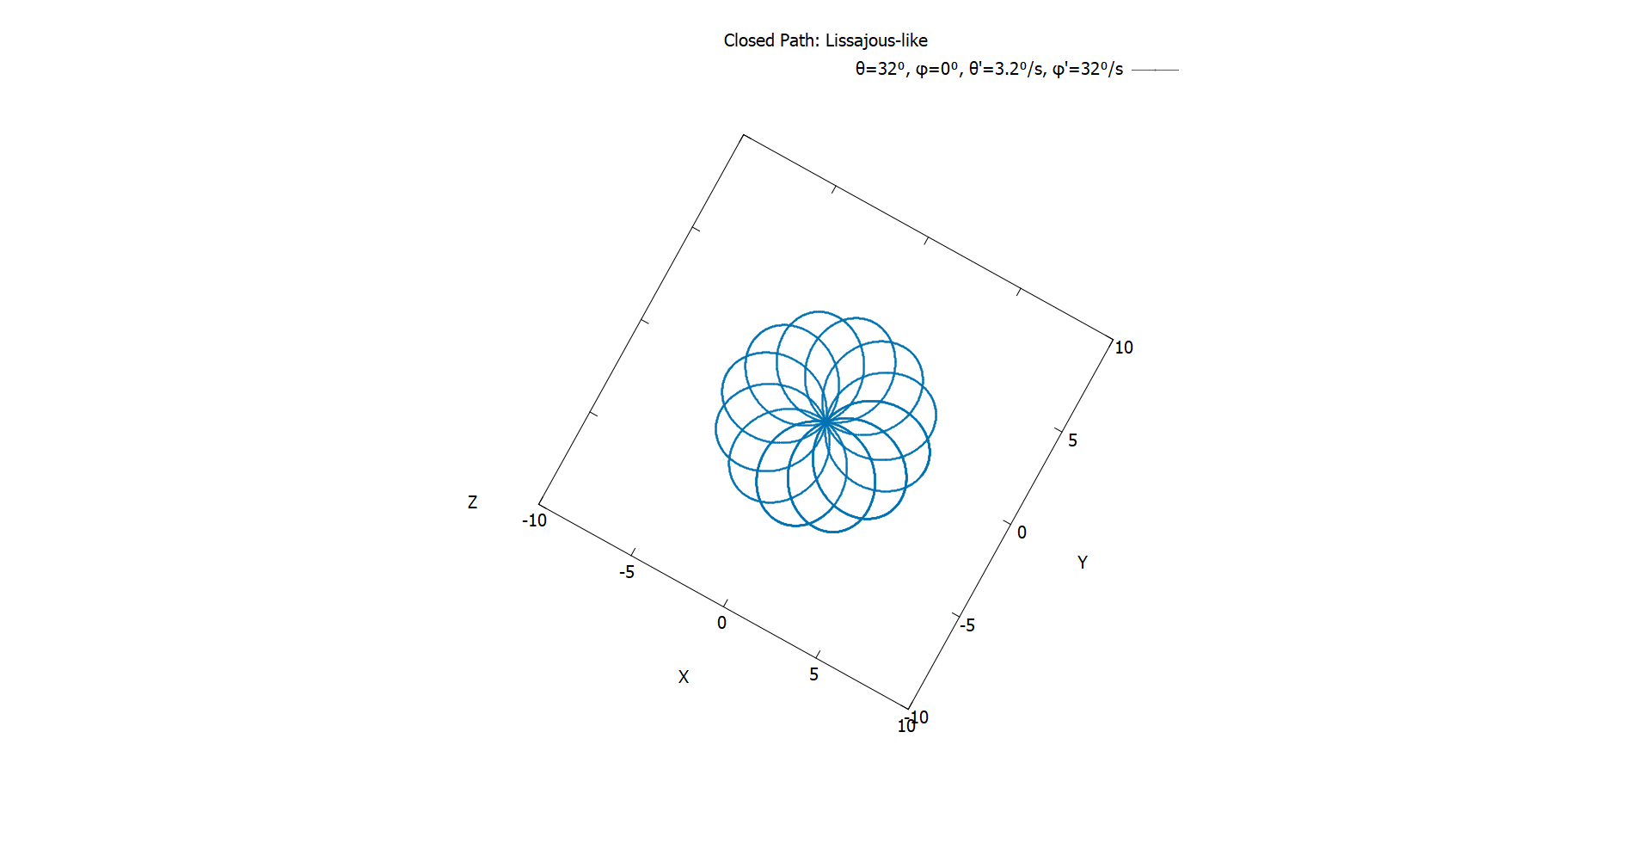
Closed paths
Mercury is the closest planet to the Sun and the smallest one in the Solar

Slide 35
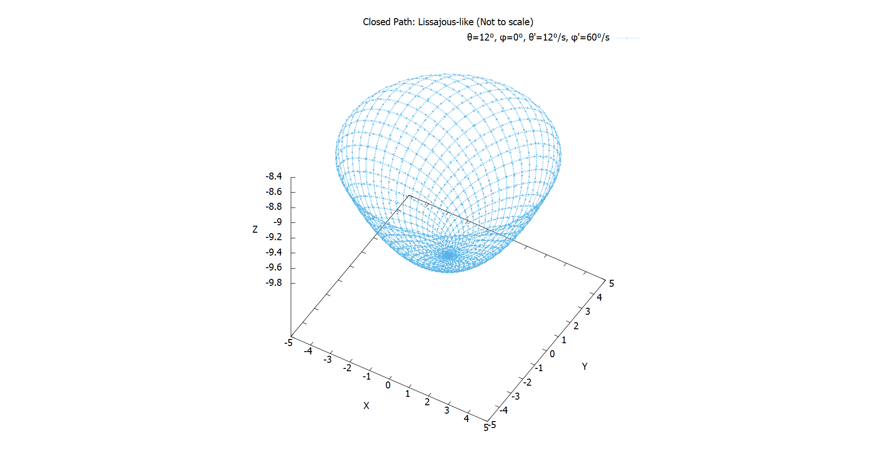
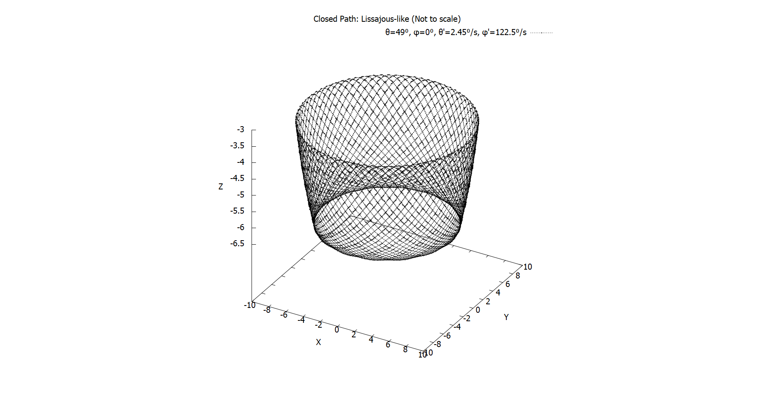
Closed paths
Mercury is the closest planet to the Sun and the smallest one in the Solar

Slide 36
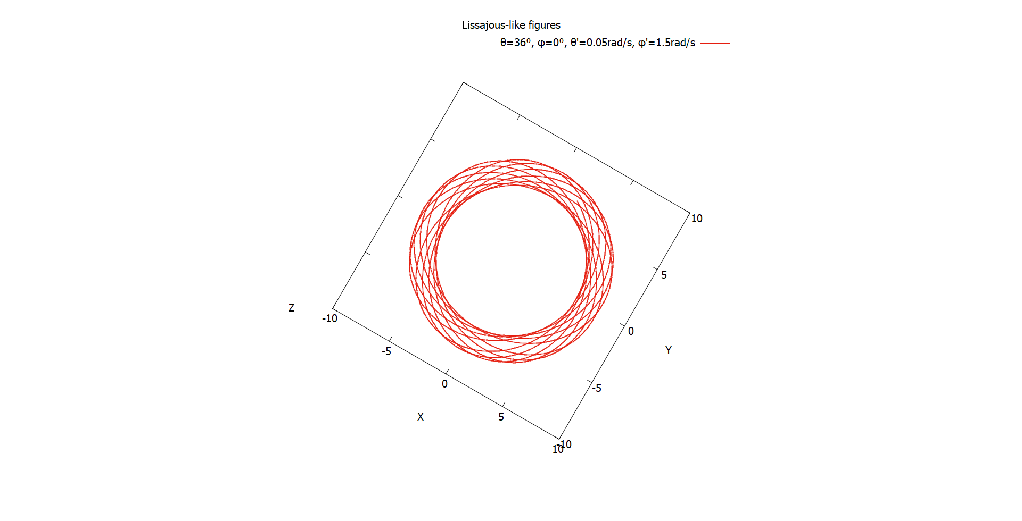
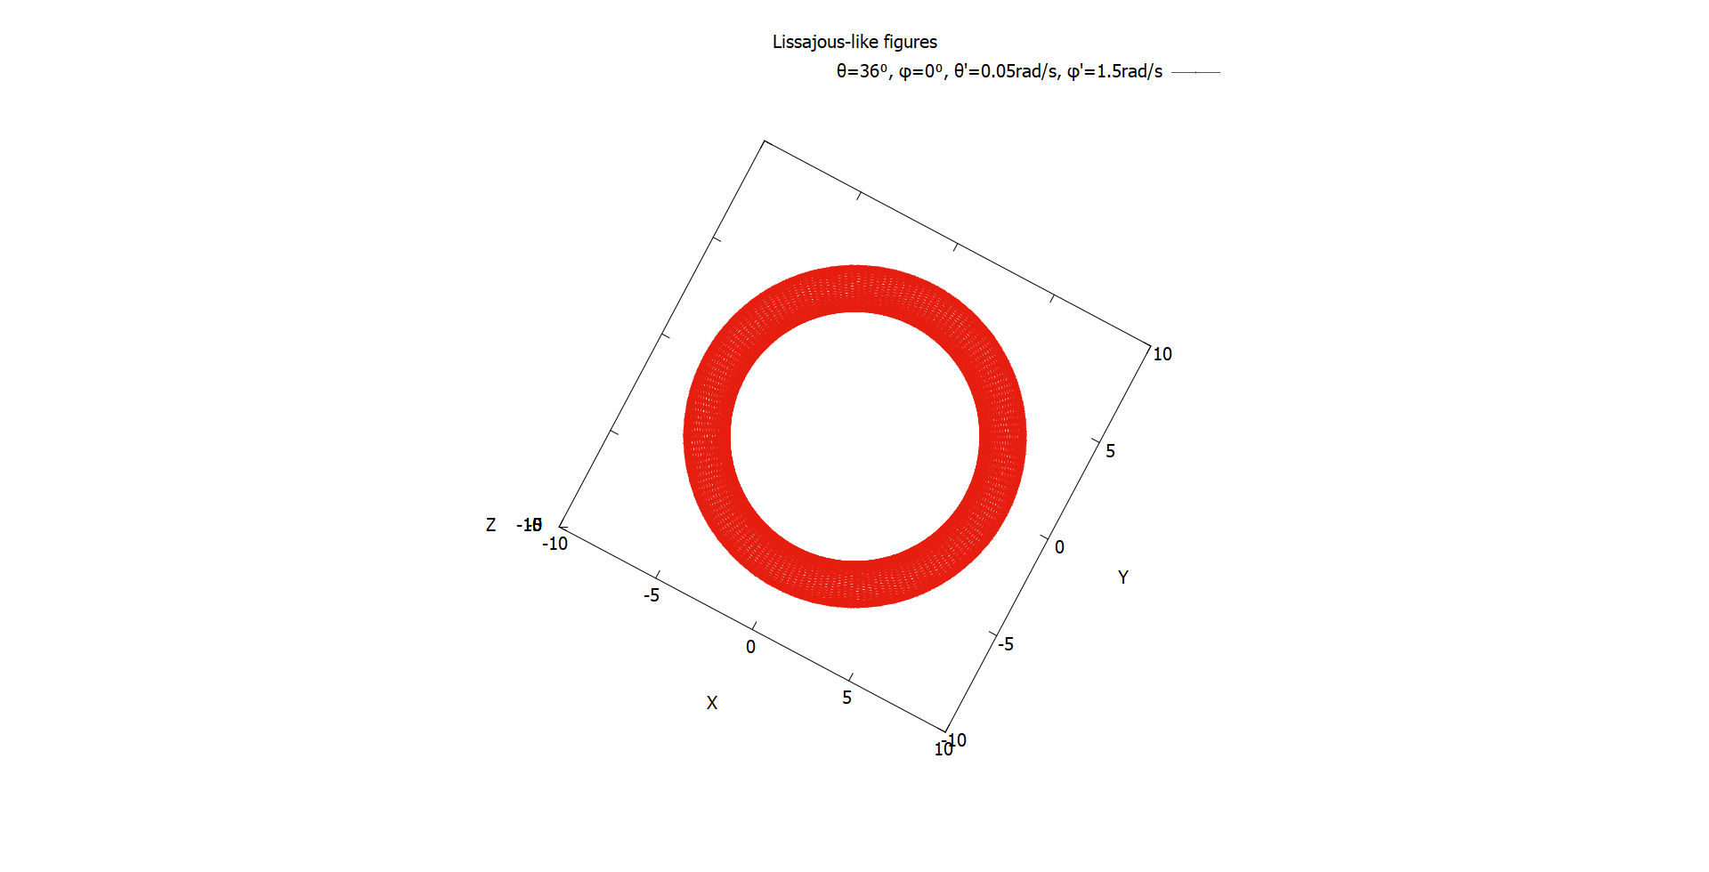
Lissajous-like figures
Mercury is the closest planet to the Sun and the smallest one in the Solar

Slide 37
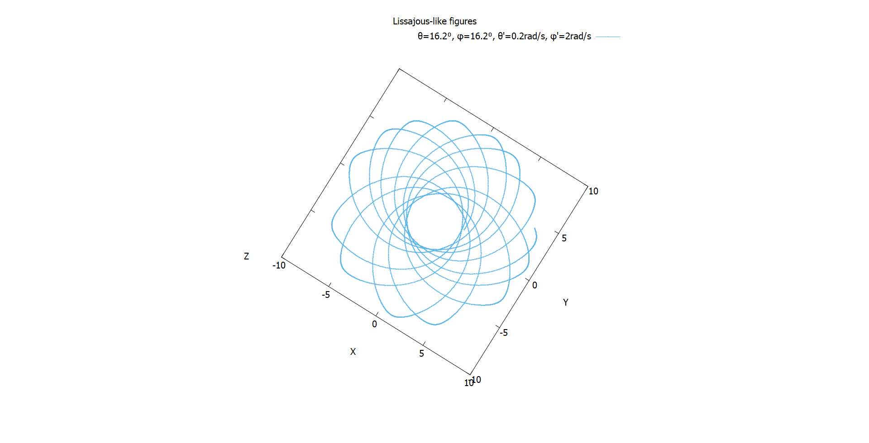
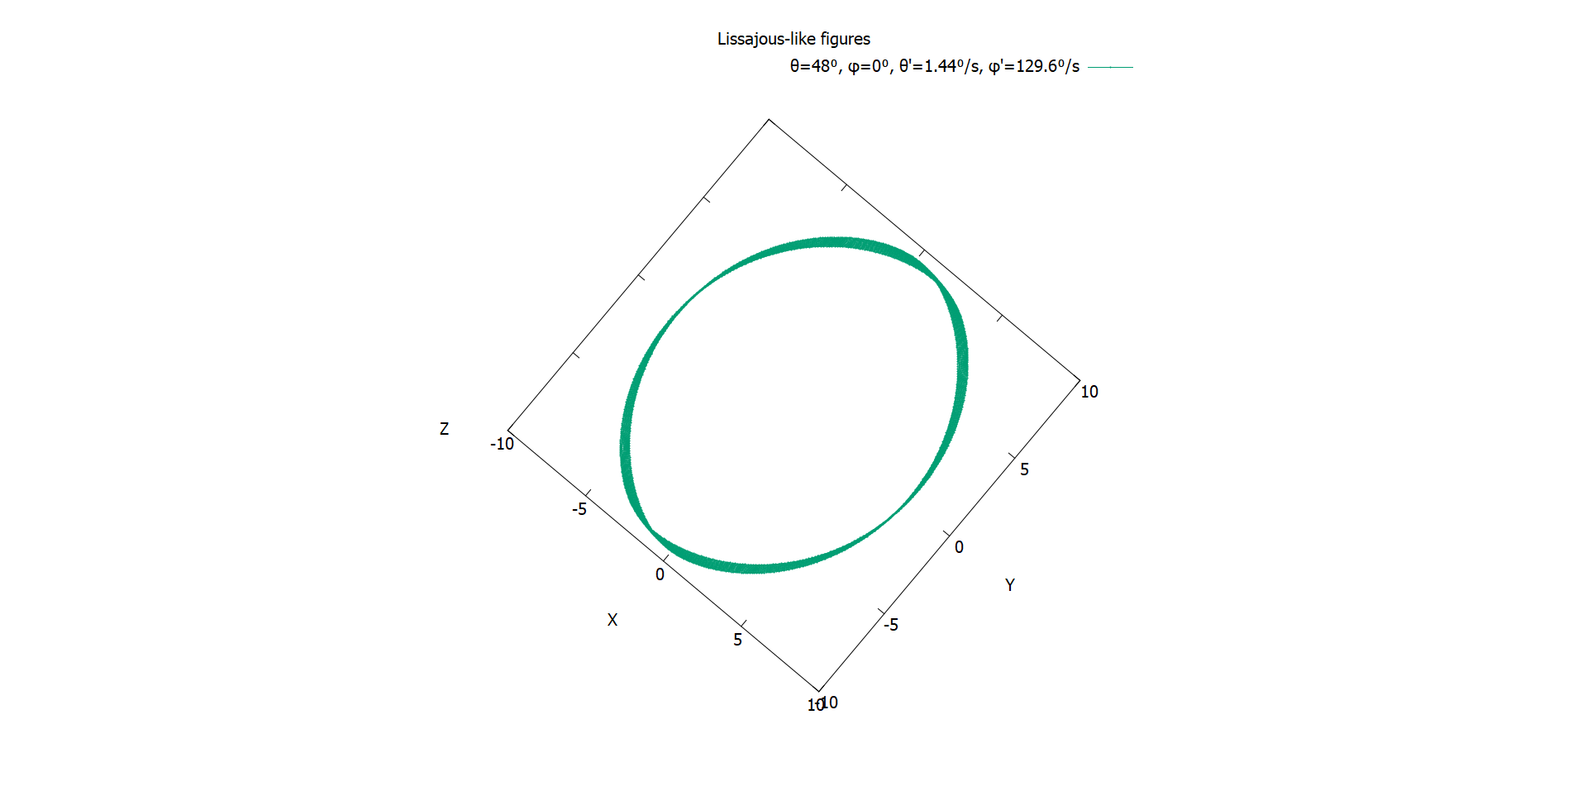
Lissajous-like figures
Mercury is the closest planet to the Sun and the smallest one in the Solar

Slide 38
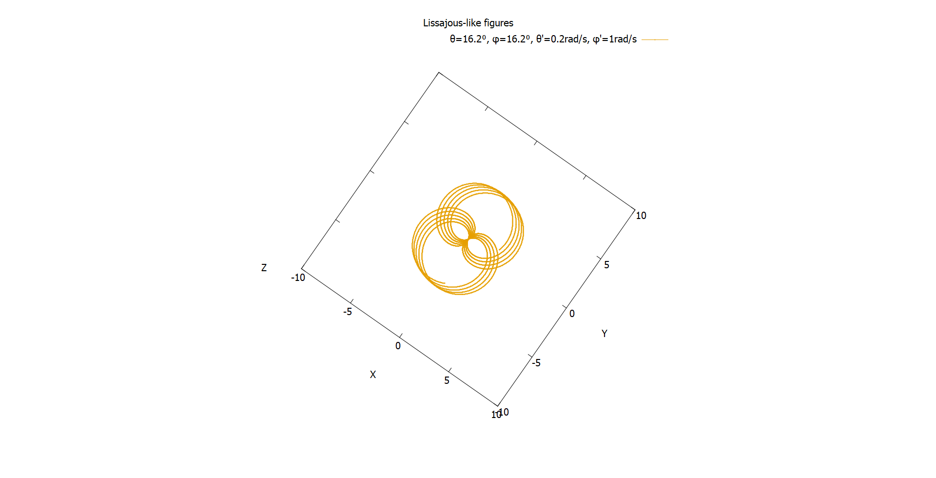
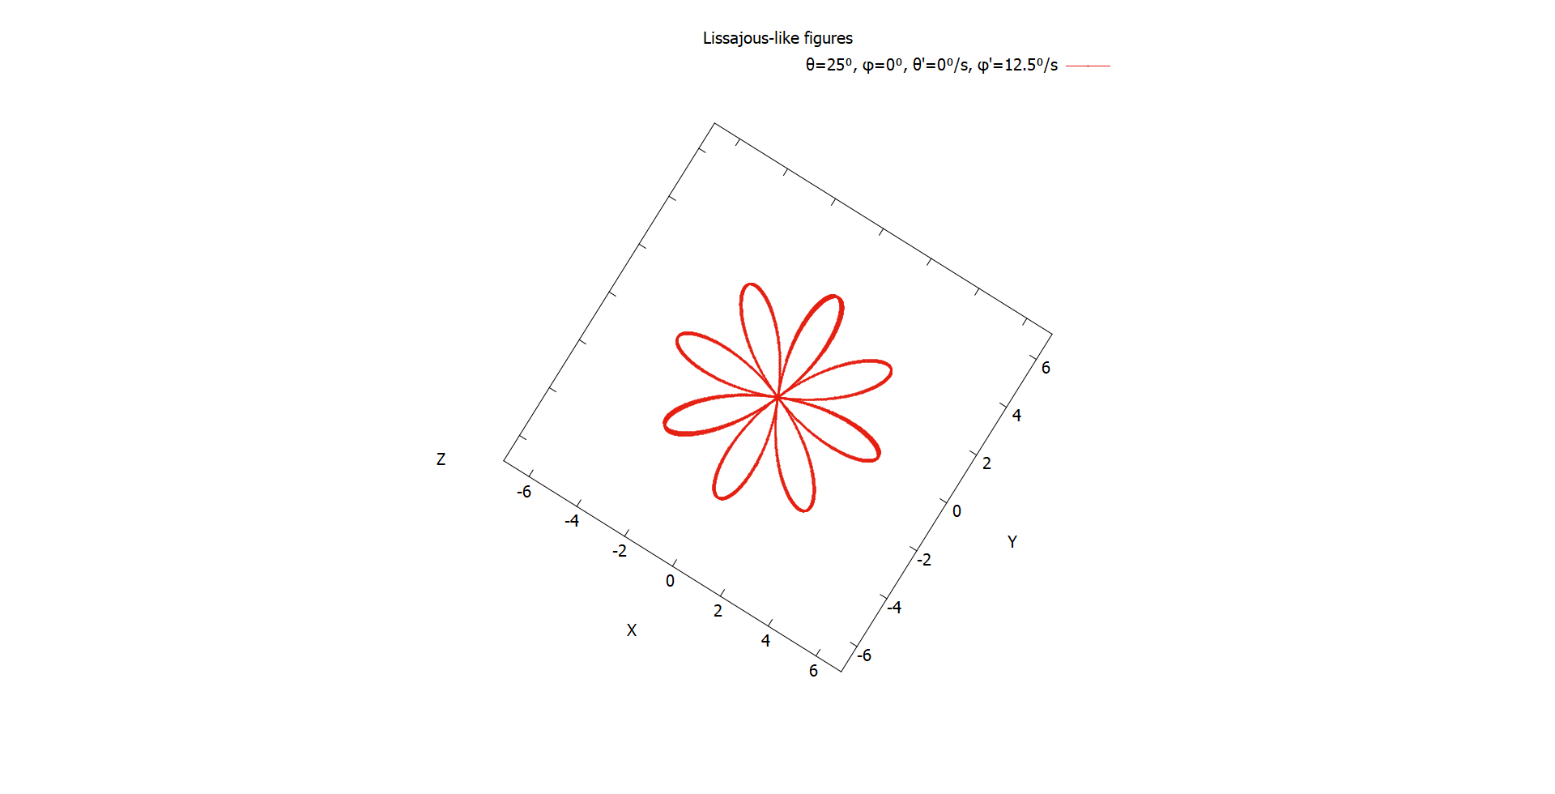
Lissajous-like figures
Mercury is the closest planet to the Sun and the smallest one in the Solar

Slide 39
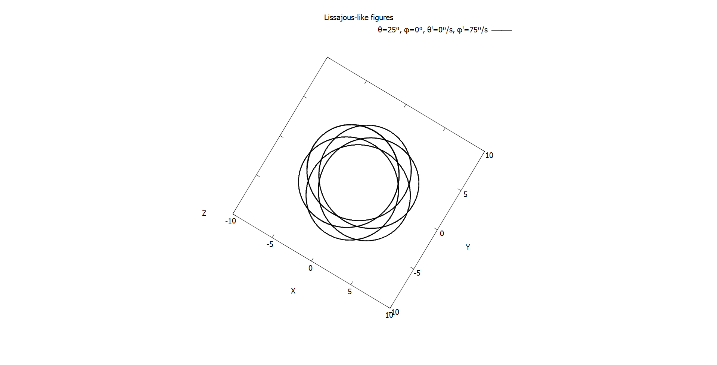
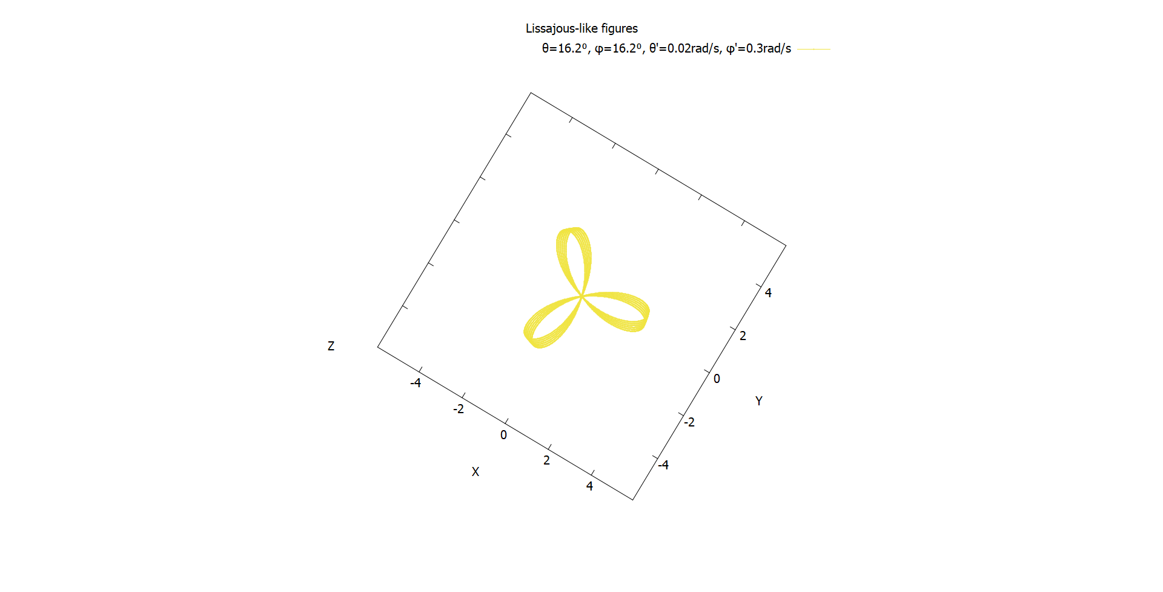
Lissajous-like figures
Mercury is the closest planet to the Sun and the smallest one in the Solar

Slide 40
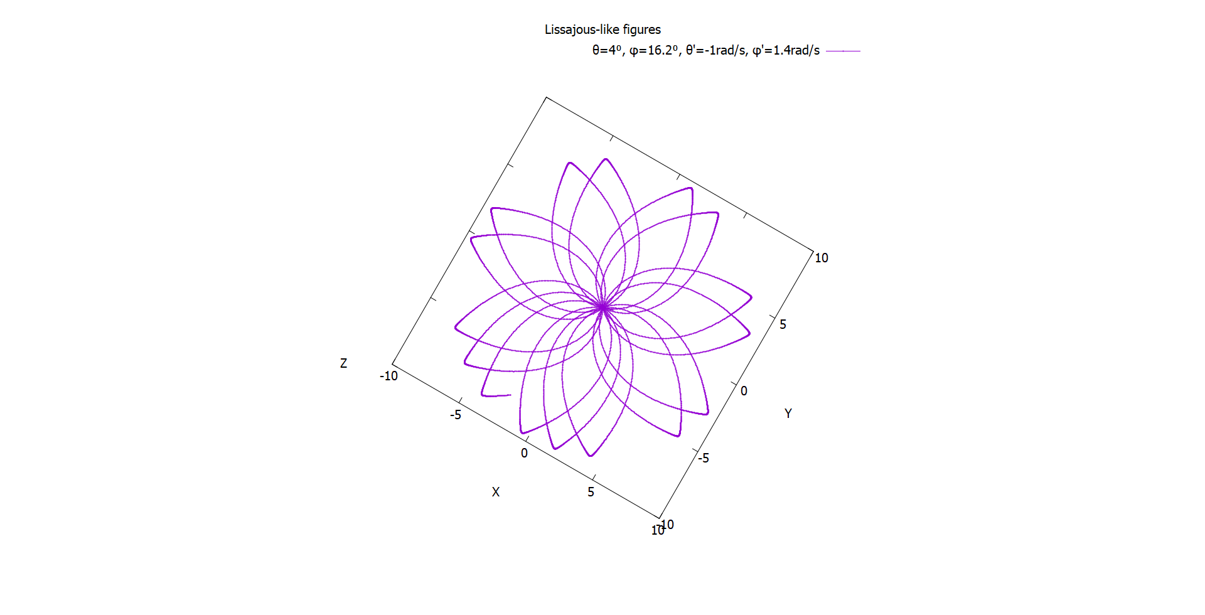

Lissajous-like figures
Mercury is the closest planet to the Sun and the smallest one in the Solar

Slide 41



Lissajous-like figures
Mercury is the closest planet to the Sun and the smallest one in the Solar

Slide 42


Adding damping effect
Mercury is the closest planet to the Sun and the smallest one in the Solar

Slide 43
Damping coefficients
Adding damping effect
Mercury is the closest planet to the Sun and the smallest one in the Solar System—it’s only a bit larger than the Moon

Slide 44
Conservation of energy

Slide 45
Conservation of angular momentum

Slide 46
Optional part

Slide 47
Our philosophy
Mercury
Venus
Mercury is the closest planet to the Sun and the smallest one in the Solar System—it’s only a bit larger than the Moon
Venus has a beautiful name and is the second planet from the Sun. It’s hot and has a poisonous atmosphere

Slide 48

A picture is worth a thousand words

Slide 49

Market trends
25%
25%
25%
25%
Venus has a beautiful name
Mercury is the smallest planet
Jupiter is the biggest planet
Mars is a very cold place
Venus
Jupiter
Mercury
Mars
Follow the link in the graph to modify its data and then paste the new one here. For more info, click here
Notes:
El gráfico de tiene que estar hecho por Google Sheets. Hay que incluir una leyenda para que el usuario pueda incluir información de la gráfica

Slide 50
Thanks!
Do you have any questions?
addyouremail@freepik.com
+91 620 421 838
yourcompany.com
Please keep this slide for attribution

Slide 51
Resources
Did you like the resources on this template? Get them for free at our other websites.
Photos:
Front view of man doing a presentation during a meeting
Studio portrait of beautiful woman
Person working as part of company team
Front view of businessman with colorful cones representing growth
Vectors:
Flat design ui and ux elements
Icons:
Business icon pack

Slide 52
Fonts & colors used
This presentation has been made using the following fonts:
Raleway
(https://fonts.google.com/specimen/Raleway)
Barlow
(https://fonts.google.com/specimen/Barlow)
#363636
#ffffff
#fccf78
#f57dc6
#6aa1f7
#9d59db
#b3d5f2
#9ae6ae
#777777
#464646

Slide 53


